Slide 1
Terraform on Azure with IaC DevOps SRE | Real-World 25 Demos
Kalyan Reddy Daida

Slide 2
AWS EKS Kubernetes
DevOps on
AWS & Azure
Jenkins
Azure AKS
Part-2
STACKSIMPLIFY
Ansible
Azure AKS Kubernetes
DevOps &
SRE
Roadmap
HashiCorp Certified
Vault & Consul
Azure Certs
AZ-900, 104, 204, 400
AWS ECS
Docker on AWS
Kubernetes Certifications
CKAD, CKA, CKS
Google Cloud
Associate & Professional Certs
AWS CloudFormation
AWS Lambda
Python
Google GKE Kubernetes
HashiCorp Certified Terraform Associate on AWS with 50 Practical Demos
Terraform on AWS with SRE and IaC DevOps with 20 Real-World Demos
HashiCorp Certified Terraform Associate on Azure with 60+ Practical Demos
Terraform on Azure with IaC DevOps SRE with 20+ Real-World Demos
Terraform on AWS EKS Elastic Kubernetes Service with 15+ Real-World Demos
LIVE

Slide 3
Terraform on Azure with IaC DevOps SRE | Real-World 25 Demos
Kalyan Reddy Daida

Slide 4
Terraform Fundamentals (Commands, Language, Settings, Providers, Resources)
Azure Virtual Network, Subnets and Network Security Groups
Terraform
On
Azure Cloud
Azure Traffic Manager
Azure Virtual Machines, Network Interface and Public IP
Azure Application Gateway Basics
Azure Bastion Host and Bastion Service
Real-World
Approach
Azure Application Gateway Context Path based Routing and Multisite Hosting
Azure Standard Load Balancer with Inbound NAT Rules
Azure Application Gateway SSL, HTTP to HTTPS Redirect, SSL with Key Vault
Azure Virtual Machine Scale Sets with Manual Scaling
Step by Step Documentation
On GitHub
Terraform Local Modules – Leverage Public Registry
Azure VMSS with Autoscaling Default, Recurrence and Fixed Profiles
Terraform Local Modules – Build from scratch and Publish to Public TF Registry
Azure Standard Load Balancer (External and Internal)
Incremental way to Build Complex Infra
Terraform Remote State Storage & Remote State Datasource
Azure Private and Public DNS Zones
Azure MySQL Single Server with Azure Application Gateway
IaC DevOps with Azure DevOps for Terraform Project with Build and Release Pipelines

Slide 5
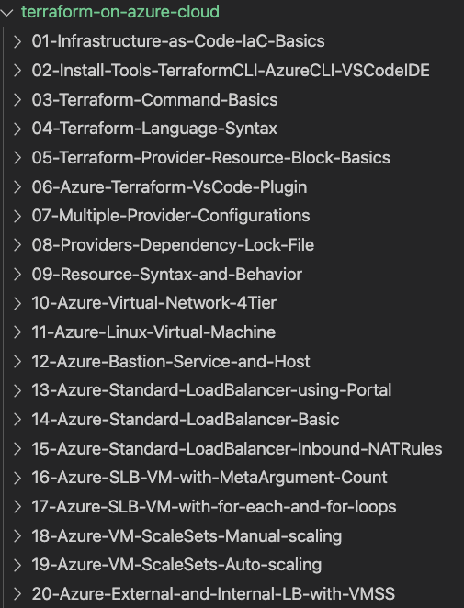
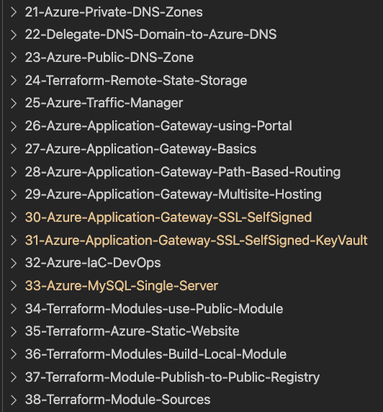
GitHub Step-by-Step Documentation
TF Configs
well kept on GitHub

Slide 6


















20 Azure Services
Resource Group
Traffic Manager
NAT Gateway
Virtual Network
Subnet
Network Security
Group
Network Interface
Virtual Machine
Azure Disk
VM Scale Set
Public IP
DNS Zone
MySQL Server
Load Balancer
LB Inbound NAT
Application
Gateway
Storage
Account
Azure DevOps
Pipelines

Slide 7
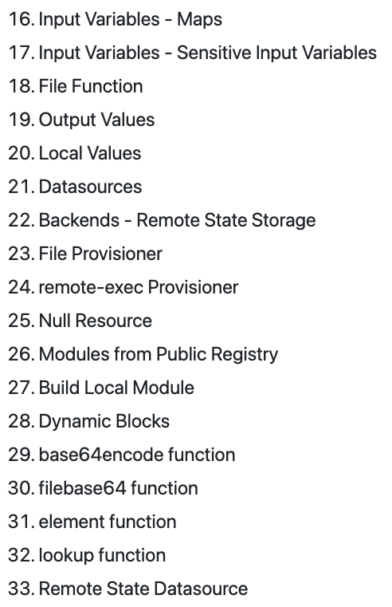
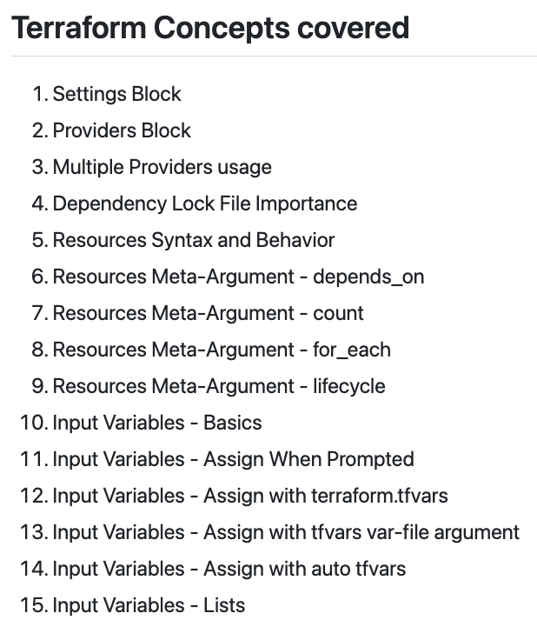
30+ Terraform
Concepts

Slide 8


Azure Cloud
30+
Terraform
Concepts
20+
Azure Resources
&
GitHub Step-by-Step Documentation

Slide 9
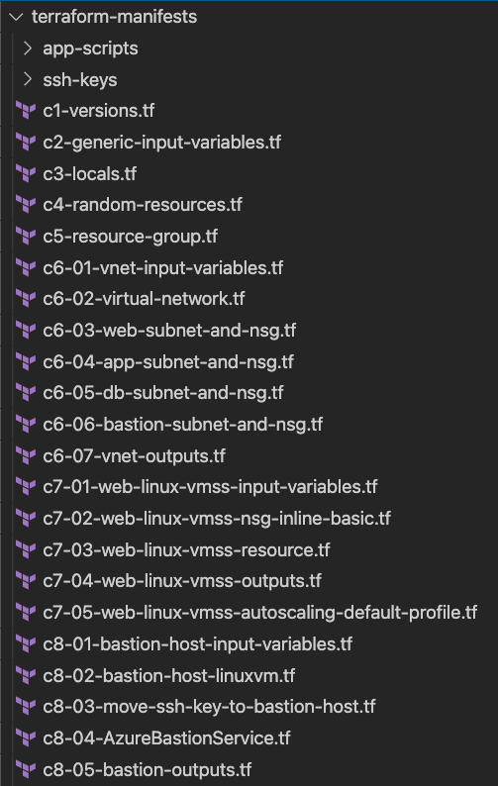
Terraform Configs
Azure Virtual Network with Subnets and Network Security Groups
Azure Virtual Machine Scale Set with Auto Scaling Profile - Web Tier
Azure Bastion Host Linux VM – Enabled
Azure Bastion Service - Disabled

Slide 10
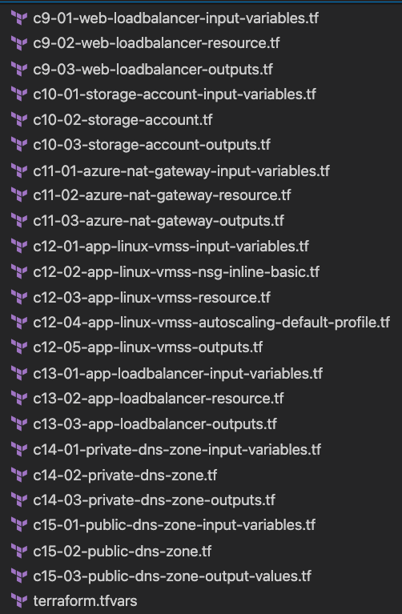
Terraform Configs
Azure Standard Load Balancer – External (Web Tier Load Balancer)
Azure Storage Account – Deploy httpd conf
Azure NAT Gateway – Outbound communication for App VMSS
Azure Virtual Machine Scale Set with Auto Scaling Profile - App Tier
Azure Standard Load Balancer – Internal (App Tier Load Balancer)
Azure Private DNS Zone for App Tier Load Balancer internal DNS Name in VNET
Azure Public DNS Zone – Access Applications via Internet using Registered Domain

Slide 11
GitHub Repositories
Repository Used For | Repository URL
Course Main Repository with step-by-step documentation | https://github.com/stacksimplify/terraform-on-azure-cloud
Azure IaC DevOps with Build and Release Pipelines | https://github.com/stacksimplify/terraform-on-azure-with-azure-devops

Slide 12
Terraform Workflow
init
validate
plan
apply
destroy
1
2
3
4
5
terraform init
terraform validate
terraform plan
terraform apply
terraform destroy

Slide 13
Terraform
Top-Level
Blocks
Terraform Block
Input Variables Block
Data Sources Block
Providers Block
Output Values Block
Modules Block
Resources Block
Local Values Block
Fundamental Blocks
Variable Blocks
Calling / Referencing Blocks

Slide 14
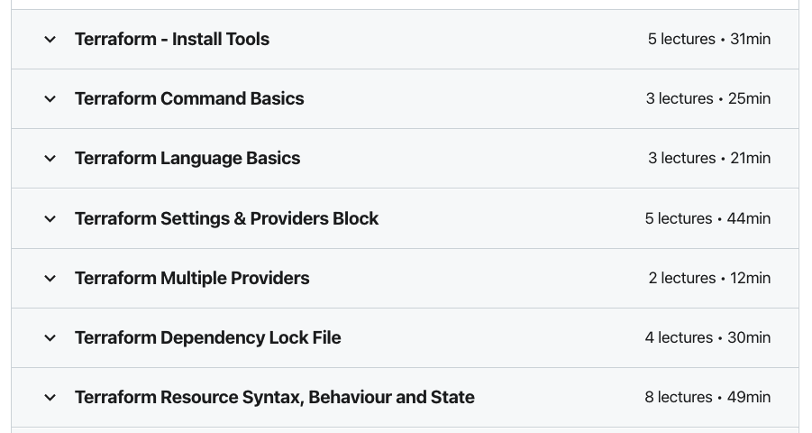
Terraform Fundamentals
We are going to learn Terraform Fundamentals for 3 hours
Continue with Real-World 25+ Demos

Slide 15

Azure Virtual Network – 4 Tier Design
Resource Group
Virtual Network
Web Tier
Subnet
Web
NSG
App Tier
Subnet
App
NSG
DB Tier
Subnet
DB
NSG
Bastion
Host Subnet
Bastion
NSG

Slide 16

Azure Linux Virtual Machine
Resource Group
Virtual Network
Web Tier
Subnet
Web
NSG
Web VM-1
Port 80, 22
App Tier
Subnet
App
NSG
User
Web Linux VM
Public IP
NIC
VM
Disk
DB Tier
Subnet
DB
NSG
Terraform file() Function
VM NSG (Optional)
Terraform filebase64() function
Bastion
Host Subnet
Bastion
NSG
Terraform base64encode() function

Slide 17
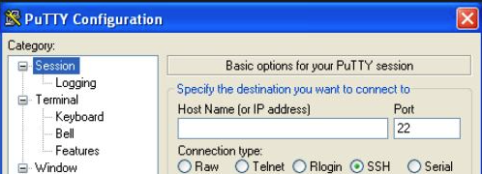

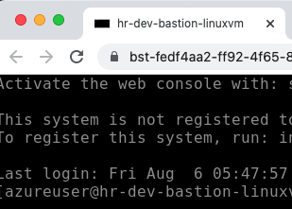

Azure Bastion Host Linux VM & Bastion Service
Resource
Group
Virtual Network
Bastion Host
Subnet
Bastion
NSG
SSH Client – Putty / Terminal
Bastion VM-1
Web Tier
Subnet
Web
NSG
Port 22
Bastion Host
Linux VM Public IP
NIC
VM
Disk
Web VM-1
NIC
VM
Disk
Admin
User
App Tier
Subnet
App
NSG
Bastion Service
Subnet
SSL Port 443
DB Tier
Subnet
DB
NSG
Browser
Bastion Service
Public IP
Azure Bastion Service

Slide 18

Azure Standard Load Balancer – Internet Facing
Resource
Group
Virtual Network
Bastion Host
Subnet
Bastion
NSG
Port 22
Bastion VM-1
SSH Client – Putty / Terminal
Bastion Host
Linux VM Public IP
NIC
VM
Disk
Port 22
Web Tier
Subnet
Web
NSG
App Tier
Subnet
App
NSG
Web VM-1
Port 80
DB Tier
Subnet
DB
NSG
LB
Public IP
NIC
VM
Disk
Users
Azure Standard
Load Balancer

Slide 19
Azure Standard Load Balancer – Inbound NAT Rules
SSH Client – Putty /
Terminal
Resource
Group
Virtual Network
Bastion Host
Subnet
Bastion
NSG
Port 22
Bastion VM-1
Bastion Host
Linux VM Public IP
NIC
VM
Disk
Admin
Port 22
SSH Port 1022
Web Tier
Subnet
Web
NSG
Inbound NAT Rules
App Tier
Subnet
App
NSG
Port 22
Web VM-1
Port 80
DB Tier
Subnet
DB
NSG
LB
Public IP
NIC
VM
Disk
Users
Azure Standard
Load Balancer

Slide 20
Azure Standard Load Balancer – Meta-Argument Count
Resource
Group
Virtual Network
Web Tier
Subnet
Web
NSG
Port 22
Web VM-1
Meta-Argument
Count
NIC
VM
Disk
Admin
Port 22
Web VM-2
SSH Port 1022,
SSH Port 2022,
SSH port 3022
NIC
VM
Disk
Inbound NAT Rules
App Tier
Subnet
App
NSG
Port 22
Web VM-3
Port 80
NIC
VM
Disk
DB Tier
Subnet
DB
NSG
Users
LB
Public IP
Azure Standard
Load Balancer

Slide 21
Azure Standard Load Balancer – Meta-Argument for_each
Resource
Group
Virtual Network
Web Tier
Subnet
Web
NSG
Port 22
Web VM-1
Meta-Argument
for_each
NIC
VM
Disk
Admin
Port 22
Web VM-2
SSH Port 1022,
SSH Port 2022,
SSH port 3022
NIC
VM
Disk
Inbound NAT Rules
App Tier
Subnet
App
NSG
Port 22
Web VM-3
Port 80
NIC
VM
Disk
DB Tier
Subnet
DB
NSG
Users
LB
Public IP
Azure Standard
Load Balancer

Slide 22
Azure Standard Load Balancer – VMSS Manual Scaling
Resource
Group
SSH Client – Putty /
Terminal
Virtual Network
Bastion Host
Subnet
Bastion
NSG
Port 22
Bastion VM-1
VMSS
Manual Scaling
Bastion Host
Linux VM Public IP
NIC
VM
Disk
Port 22
Web Tier
Subnet
Web
NSG
App Tier
Subnet
App
NSG
Web VMSS
Port 80
DB Tier
Subnet
DB
NSG
LB
Public IP
Azure Standard
Load Balancer
Web
VMSS NSG
Users

Slide 23
Azure VMSS - Autoscaling
Autoscaling Default Profile
Autoscaling
Recurrence Profile
Autoscaling Fixed Profiles
Mandatory Profile
Recur on those days with start time specified
Executes on that specific day
Defaults to round the clock schedule
Week Day and Weekend profiles
Fixed profile takes priority 1 for execution on that day if exists
Will not execute if Recurrence or Fixed Profile exists
Business Hour and Non-Business Hour profile
P3
P2
P1
Priority Execution Order for Autoscaling Profiles

Slide 24
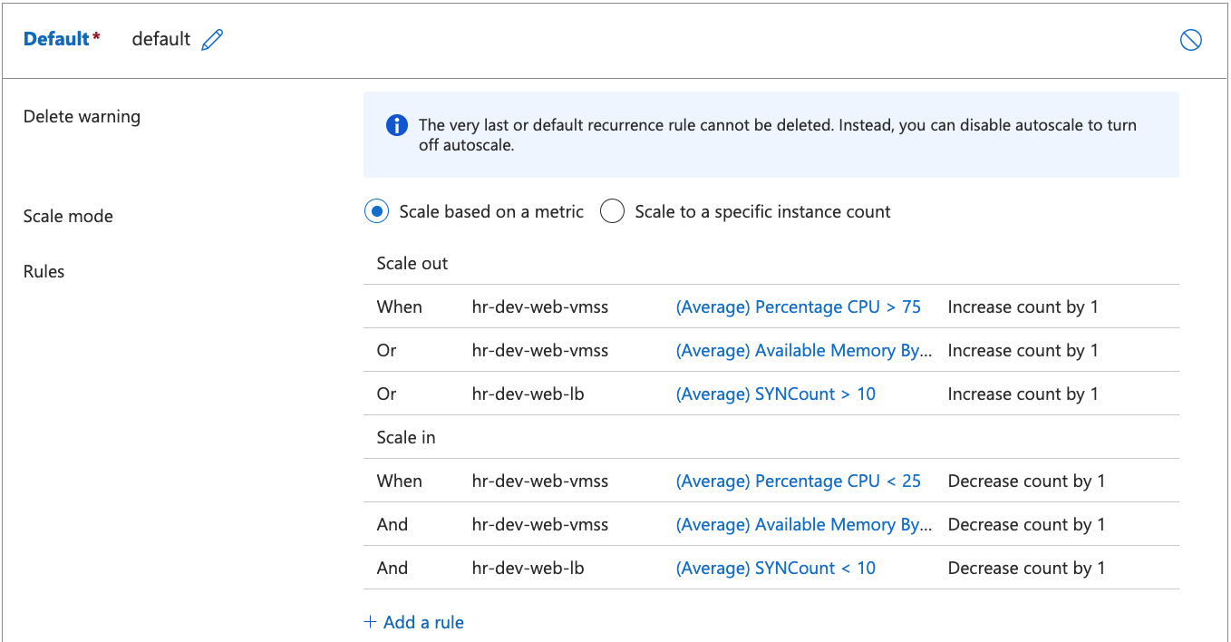
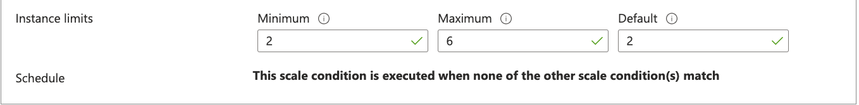
Autoscaling Default Profile
Scale Out
Scale In
Default Profile

Slide 25
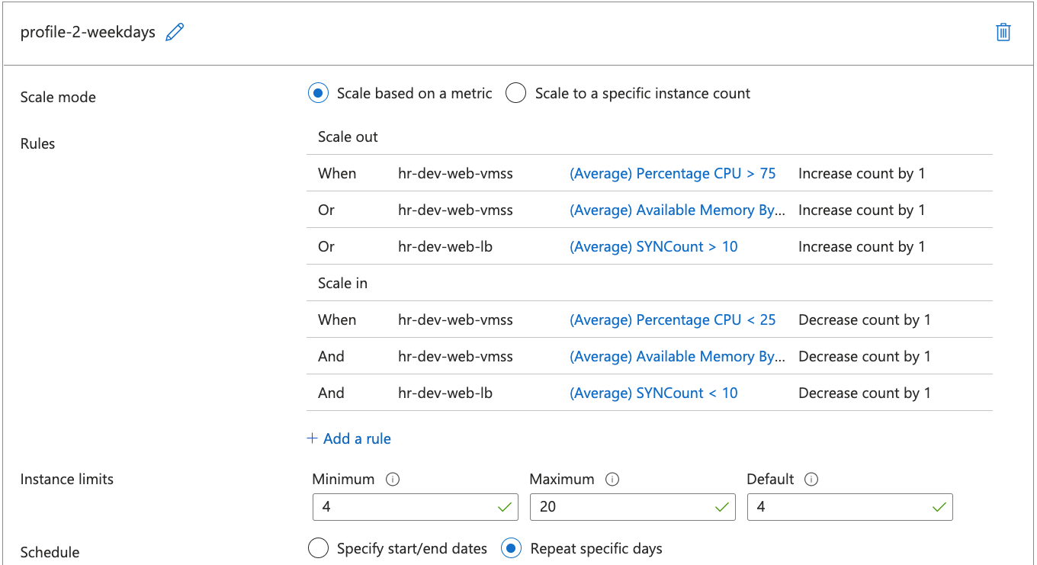
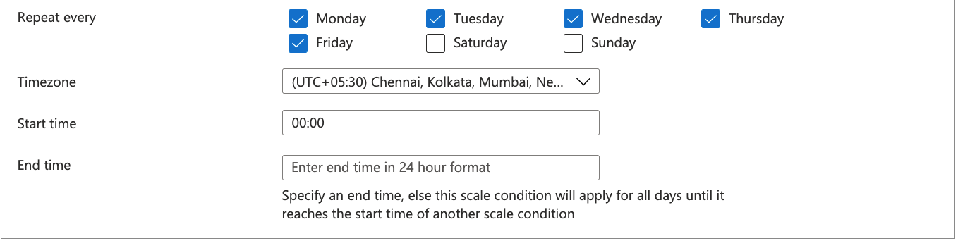
Autoscaling Recurrence Profile Week Days
Recurrence
Week Days

Slide 26
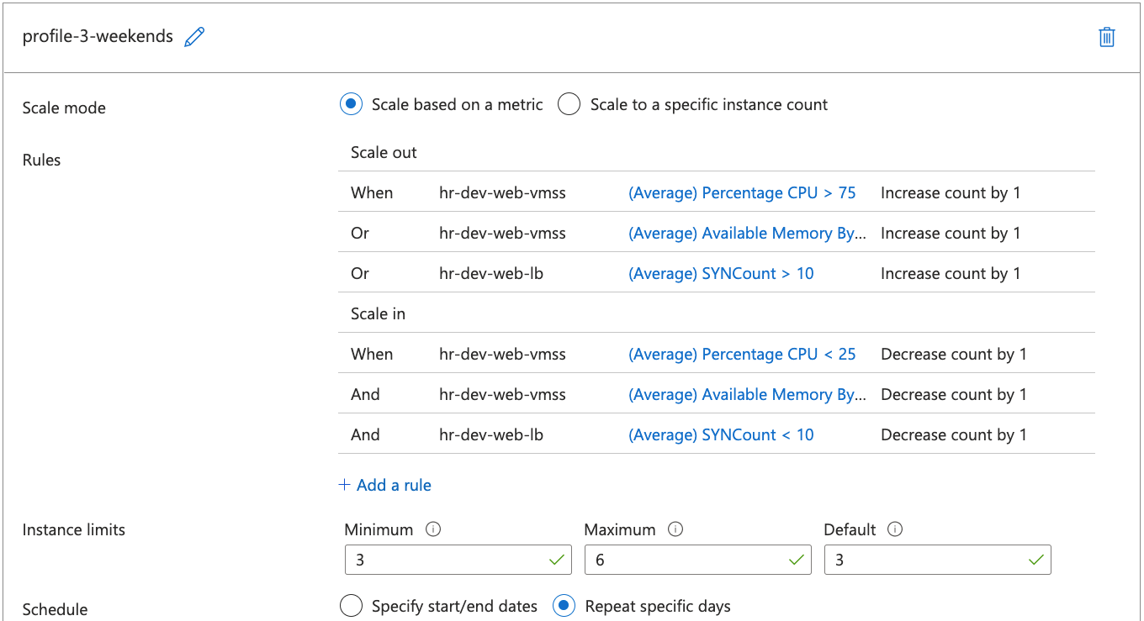
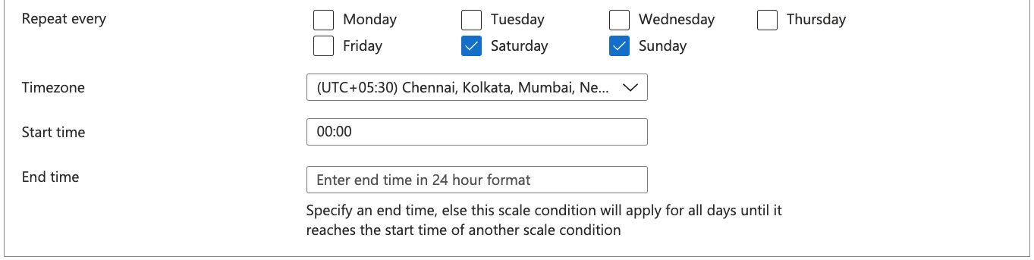
Autoscaling Recurrence Profile Weekends
Recurrence
Weekends

Slide 27
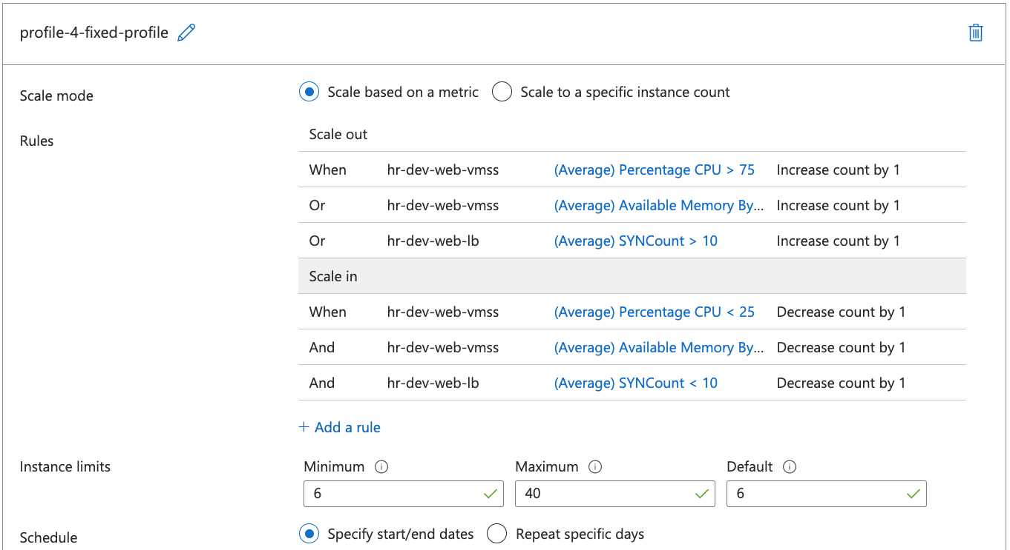
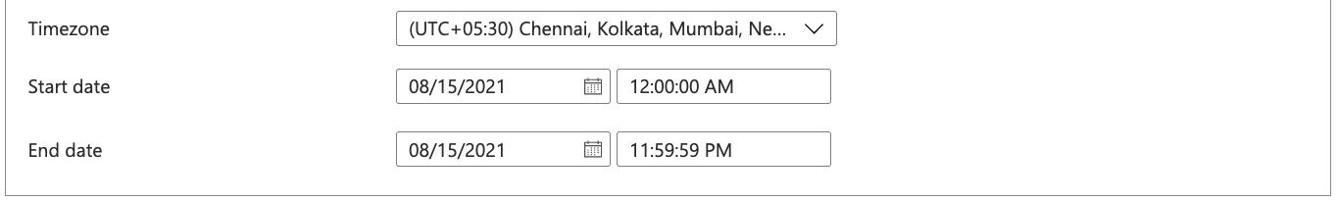
Autoscaling Fixed Profile
Fixed Date
Profile

Slide 28
Azure - External LB + Web VMSS + Internal LB + App VMSS
Internet
Resource
Group
NAT Gateway
Public IP
Virtual Network
NAT Gateway
Web Tier
Subnet
Web
NSG
App Tier
Subnet
App
NSG
Web VMSS
App VMSS
Port 80
Users
LB
Public IP
Azure Standard
Load Balancer
Internal
LB
Web
VMSS NSG
App
VMSS NSG
DB Tier
Subnet
DB
NSG
Storage
Account
Download app1.conf from Storage Container to Web VMSS Apache

Slide 29
Azure - Private DNS Zones
Internet
Resource
Group
Private DNS Zone
terraformguru.com
NAT Gateway
Public IP
Virtual Network
applb.terraformguru.com
NAT Gateway
Web Tier
Subnet
Web
NSG
App Tier
Subnet
App
NSG
Web VMSS
App VMSS
Port 80
Users
LB
Public IP
Azure Standard
Load Balancer
Internal
LB
Web
VMSS NSG
App
VMSS NSG
DB Tier
Subnet
DB
NSG
Storage
Account
Download app1.conf from Storage Container to Web VMSS Apache

Slide 30



Azure - Public DNS Zones
Internet
Resource
Group
Private DNS Zone
terraformguru.com
NAT Gateway
Public IP
Resource
Group
Virtual Network
DNS Records
kubeoncloud.com
www.kubeoncloud.com
app1.kubeoncloud.com
NAT Gateway
applb.terraformguru.com
Public DNS Zone
kubeoncloud.com
Web Tier
Subnet
Web
NSG
App Tier
Subnet
App
NSG
Web VMSS
App VMSS
Port 80
Users
LB
Public IP
Azure Standard
Load Balancer
Internal
LB
http://kubeoncloud.com
http://www.kubeoncloud.com
http://app1.kubeoncloud.com
Web
VMSS NSG
App
VMSS NSG
DB Tier
Subnet
DB
NSG
Storage
Account
Download app1.conf from Storage Container to Web VMSS Apache

Slide 31
What is Terraform Backend ?
Backends are responsible for storing state and providing an API for state locking.
Terraform State Storage
Terraform State Locking
Azure Storage Account

Slide 32
Terraform Remote State Datasource
Project-1: eastus2
Azure VNET + LB + VMSS
Project-3: eastus2
project-1-terraform.tfstate
Azure Traffic Manager
terraform_remote_state data source
Project-2: westus2
project-3-terraform.tfstate
Azure VNET + LB + VMSS
The terraform_remote_state data source retrieves the root module output values from some other Terraform configuration, using the latest state snapshot from the remote backend.
project-2-terraform.tfstate

Slide 33
Azure – Traffic Manager
Resource
Group
Virtual Network
Region: eastus2
Web Tier
Subnet
Web
NSG
Web VMSS
Web
VMSS NSG
LB
Public IP
Azure Standard
Load Balancer
Resource Group
mytfdemo-wquift.trafficmanager.net
Resource
Group
Virtual Network
Users
Azure Traffic Manager
Region: westus2
Web Tier
Subnet
Web
NSG
Region: eastus2
Web VMSS
Web
VMSS NSG
LB
Public IP
Azure Standard
Load Balancer

Slide 34
Azure Application Gateway – using Azure Portal
Create Azure Application Gateway manually
Resource
Group
AG – Backend Pools
Virtual Network
AG – Frontend IP Configs
App Tier
Subnet
App
NSG
AG – Listeners
Create AG using Azure Portal
DB Tier
Subnet
DB
NSG
AG – HTTP Settings
AG – Rules
AG – Health Probes
AG
NSG
Web Tier
Subnet
Web
NSG
AG Subnet
Port 80
Web VMSS
Azure Application
Gateway LB
LB Public IP
Users

Slide 35
Azure Application Gateway – using Terraform
Create Azure Application Gateway using Terraform
Resource
Group
AG – Backend Pools
Virtual Network
AG – Frontend IP Configs
App Tier
Subnet
App
NSG
AG – Listeners
DB Tier
Subnet
DB
NSG
AG – HTTP Settings
AG – Rules
AG – Health Probes
AG
NSG
Web Tier
Subnet
Web
NSG
AG Subnet
Port 80
Web VMSS
Azure Application
Gateway LB
LB Public IP
Users

Slide 36
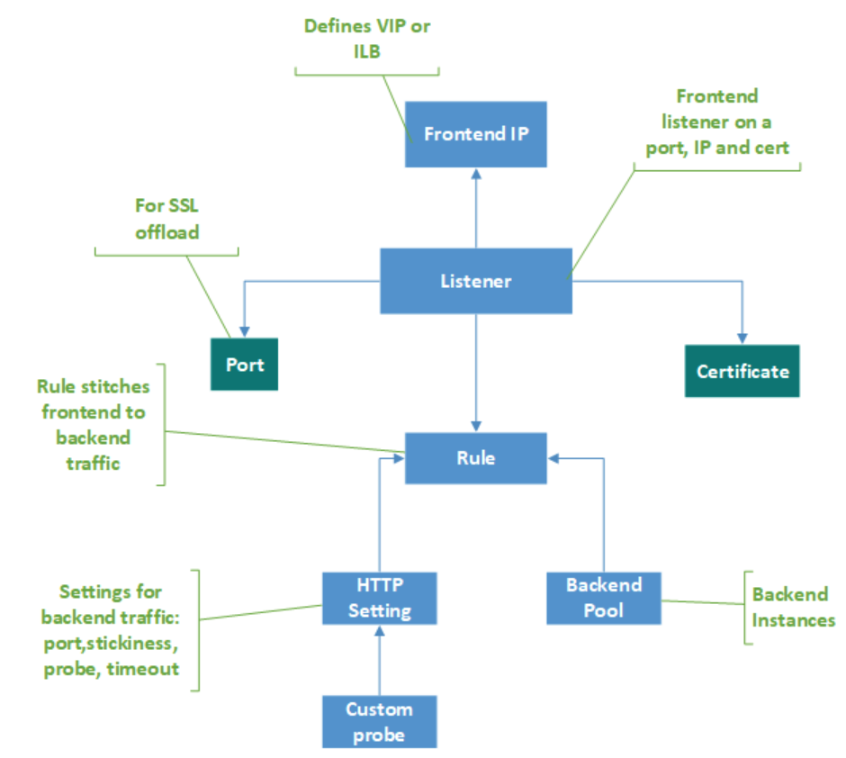
Azure Application Gateway Components

Slide 37
Azure Application Gateway – Context Path based Routing
Resource
Group
Virtual Network
Web Tier
Subnet
Web
NSG
App1 VMSS
http://ag-public-ip/app1/
+
http://ag-public-ip/app2/
AG
NSG
http://ag-public-ip/
AG Subnet
/app1/*
/app2/*
Azure Application
Gateway LB
Users
LB Public IP
/*
App2 VMSS
+
External Site
stacksimplify.com

Slide 38
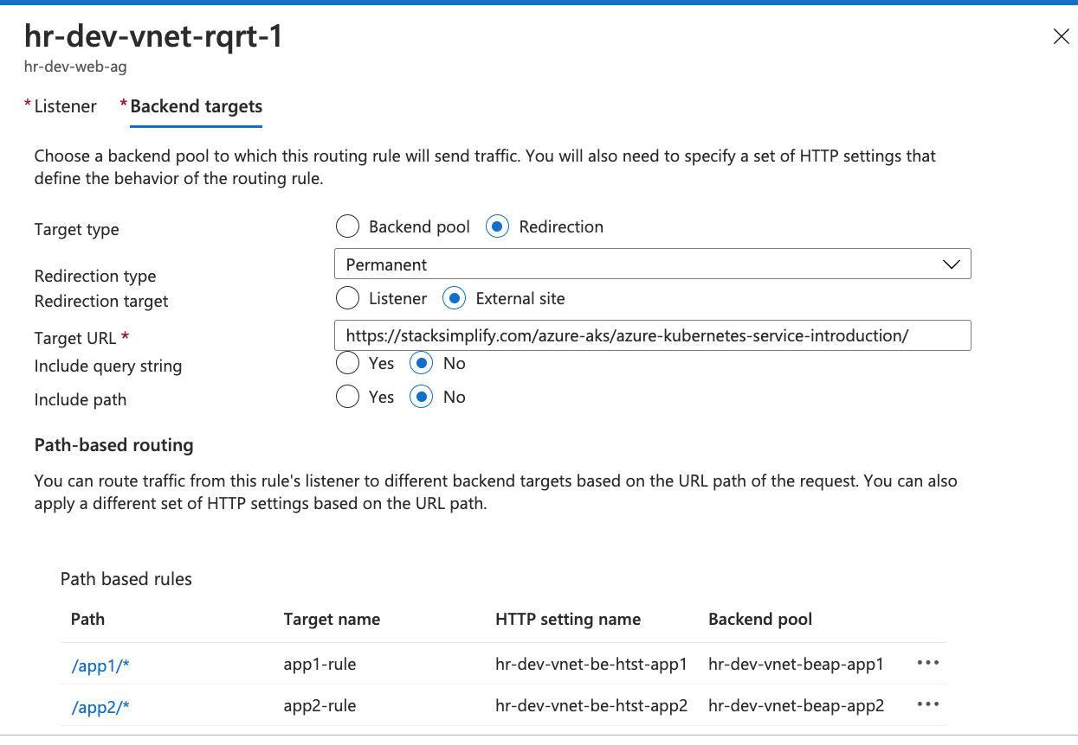
Path Based Routing
Root Context
External Redirect
Context Path based Routing

Slide 39
Azure Application Gateway – Multisite Hosting
Resource
Group
Virtual Network
Web Tier
Subnet
Web
NSG
App1 VMSS
http://app1.terraformguru.com/index.html
http://app1.terraformguru.com/app1/index.html
+
AG Subnet
app1.terraformguru.com
Azure Application
Gateway LB
app2.terraformguru.com
Users
LB Public IP
AG
NSG
App2 VMSS
http://app2.terraformguru.com/index.html
http://app2.terraformguru.com/app2/index.html
+

Slide 40

Azure Application Gateway – SSL Self-signed
Resource
Group
Virtual Network
Web Tier
Subnet
Web
NSG
App1 VMSS
+
AG Subnet
Azure Application
Gateway LB
http://terraformguru.com
https://terraformguru.com
HTTP
To
HTTPs
Redirect
SSL
Certs
AG
Error
Pages
Azure
Storage
Account
Users
LB Public IP
AG
NSG
502.html
403.html

Slide 41


Azure Application Gateway – SSL from Key Vault
Resource
Group
Virtual Network
Web Tier
Subnet
Web
NSG
AG Subnet
Azure Application
Gateway LB
http://terraformguru.com
https://terraformguru.com
App1 VMSS
+
HTTP
To
HTTPs
Redirect
SSL
Certs
AG
Error
Pages
Users
LB Public IP
Azure
Storage
Account
AG
NSG
Access SSL Certificate from Key Vault
502.html
403.html
Azure Key Vault
User Assigned
Managed Identity

Slide 42

Azure Pipelines – Key Concepts
Pipeline
Stages
Steps
Trigger
Stage-1: Build
Agent
Step-1: script: List Command: ls -R $(System.DefaultWorkingDirectory)
Job
Stage-2: AA
Step-2: Task-2: Copy Files to Build Artifact Directory
Github
Agent
Stage-3: BB
Job
Step-3: script: List Command: ls -R $(Build.ArtifactStagingDirectory)
Stage-4: CC
Job
Step-4: Task-3: Publish Artifacts to Azure Pipelines
Developer

Slide 43
Azure DevOps – Build Pipeline
Continuous Integration Pipeline
Task-1
Copy files (terraform-manifests folder) from System default working Directory to Build Artifact Directory
Task-2
Publish Build Artifacts to Azure Pipelines, so that we can use them in Release Pipelines

Slide 44




Developer
Github
Azure DevOps – Release Pipelines
1
2
Azure Cloud
Azure DevOps
Release Pipelines
QA
Azure Pipelines
5
Stage-1: Publish Artifacts to Release Pipelines
3
Dev
Staging
9
Prod
Storage Account
for State Files
7
4
6
10
8
Resource Group
Resource Group
Resource Group
Resource Group
Virtual Network
Virtual Network
Virtual Network
Virtual Network
Web Subnet
Web Subnet
Web Subnet
Web Subnet
Dev VM
Web
NSG
QA VM
Web
NSG
Stage VM
Web
NSG
Prod VM
Web
NSG
Public IP
Public IP
Public IP
Public IP

Slide 45
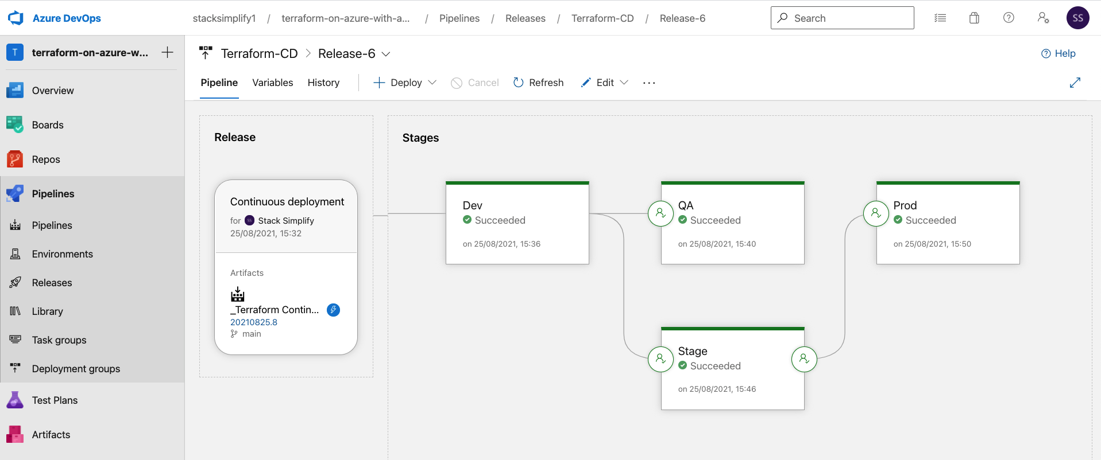
Azure IaC DevOps – Release Pipeline

Slide 46
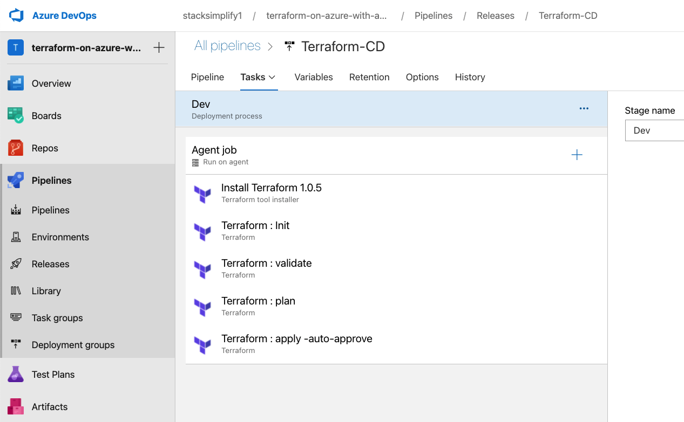
Azure IaC DevOps Release Pipelines

Slide 47
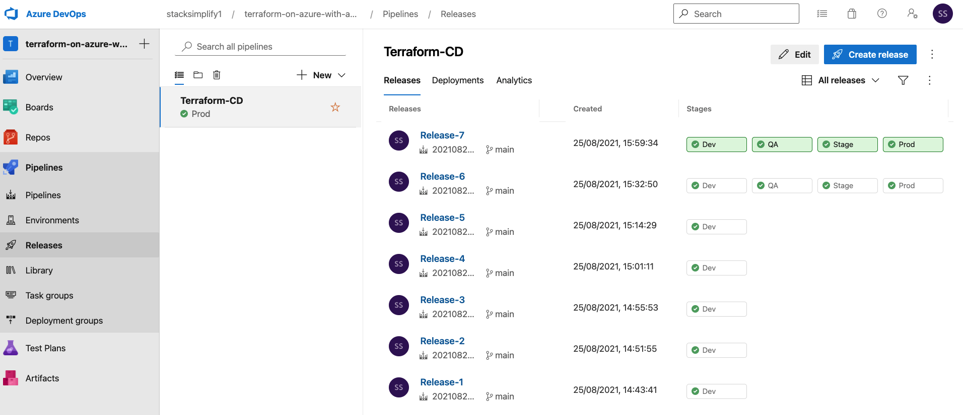
Azure IaC DevOps Releases

Slide 48
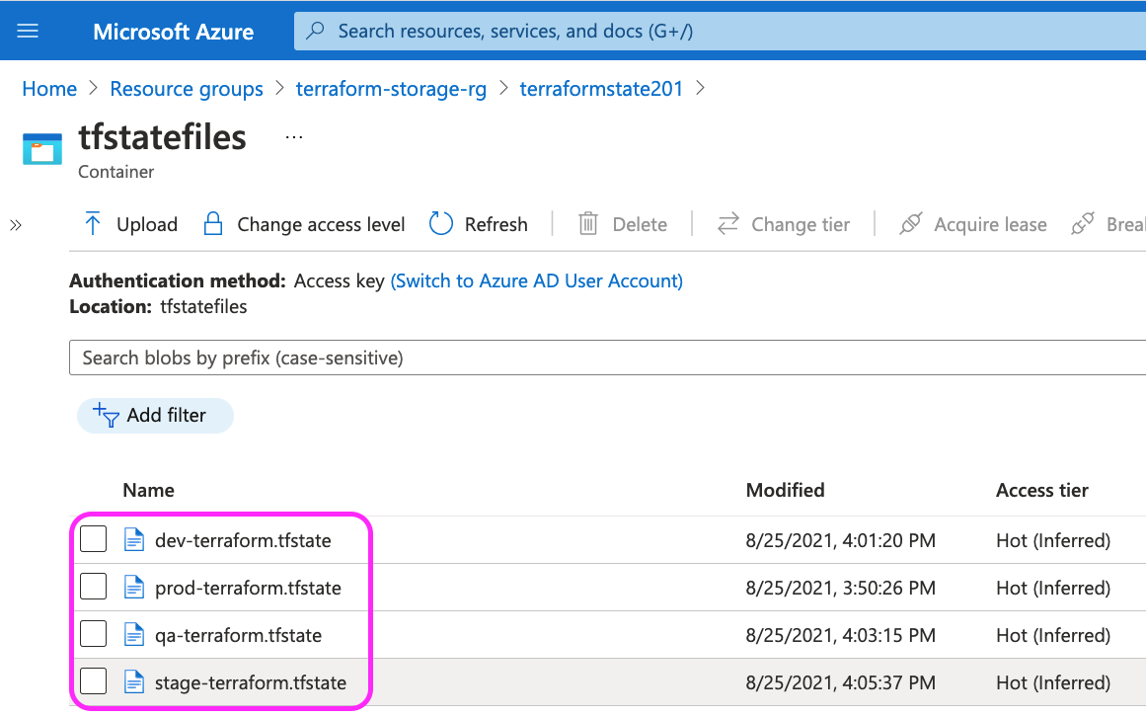
Azure IaC DevOps Environment TF State Files

Slide 49
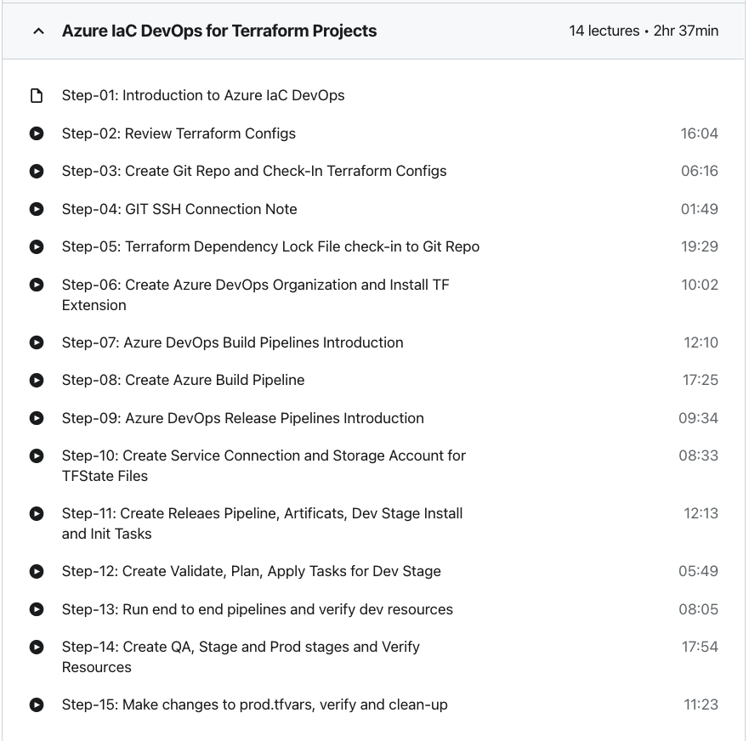
Time it takes to complete this Demo
Real-World Demo 23

Slide 50
Azure MySQL Single Server
Azure Cloud
Resource
Group
Virtual Network
Web Tier
Subnet
App1 VMSS
+
VNET Service Endpoint
Web
NSG
MySQL Virtual Network Rule
AG Subnet
Azure Application
Gateway LB
http://terraformguru.com
https://terraformguru.com
HTTP
To
HTTPs
Redirect
SSL
Certs
AG
Error
Pages
Azure
Storage
Account
Azure MySQL Single Server
LB Public IP
Users
AG
NSG
502.html
403.html

Slide 51
User Management Web Application
Spring Boot User Management
Web Application
(Java)
MySQL DB
UMS Web App with Create User, List User, Login and Logout Features
UMS Web App DB information can be passed via Environment Variables (DB Name, Port User, Pass)
UMS Web App Listens on Port 8080
New users created will be stored in MySQL DB
UMS Web App needs MySQL DB to store its users. If connection to DB fails, it cannot start
We can login with new users created to UMS Web App

Slide 52
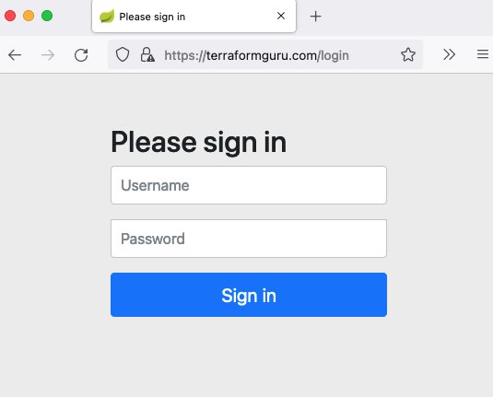
UMS – Login Screen

Slide 53
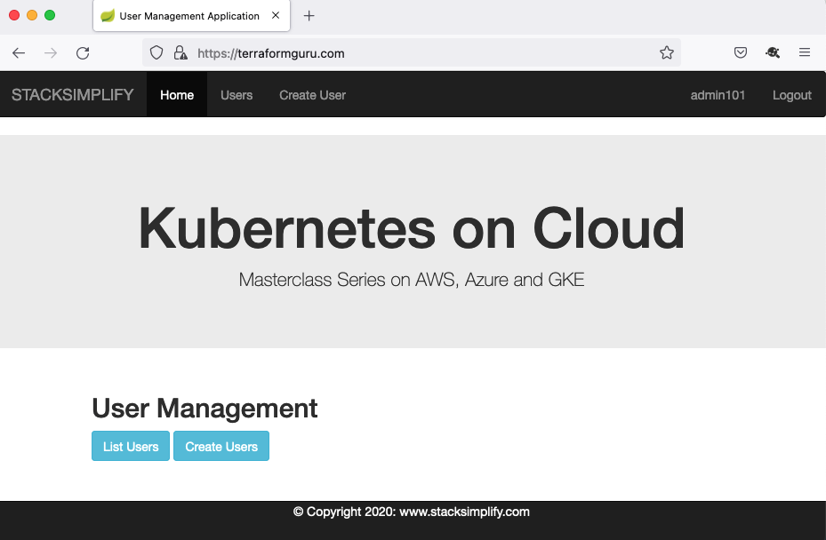
UMS – Landing Page Post Login

Slide 54
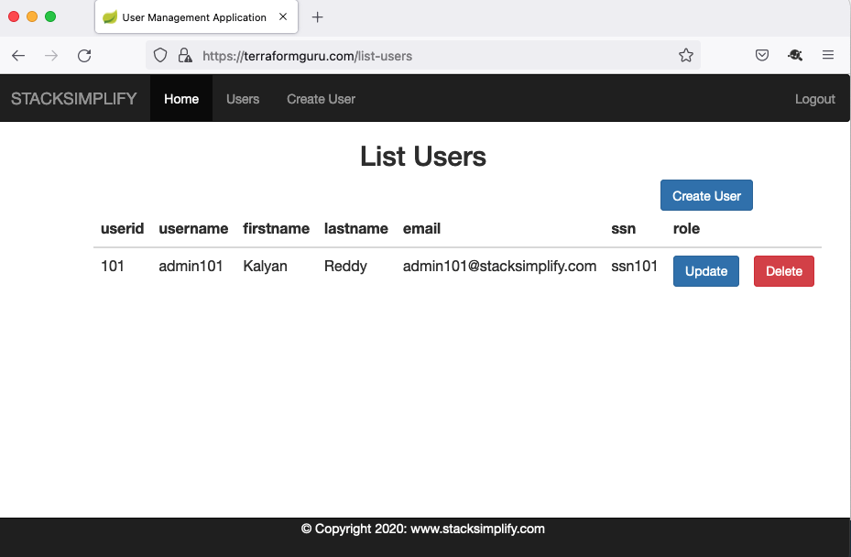
UMS – List Users Screen

Slide 55
Use a Public Registry module in our TF Configs
Build a Local Terraform Module and call it from Root Module and Test
Demo-1
Demo-3
Terraform Modules
Demo-2
Demo-4
1. Build a Static Website using Azure manually using Azure Portal.
2. Automate it using Terraform Resources
Publish to Public Terraform Registry and Access it from Public Registry and Test.

Slide 56
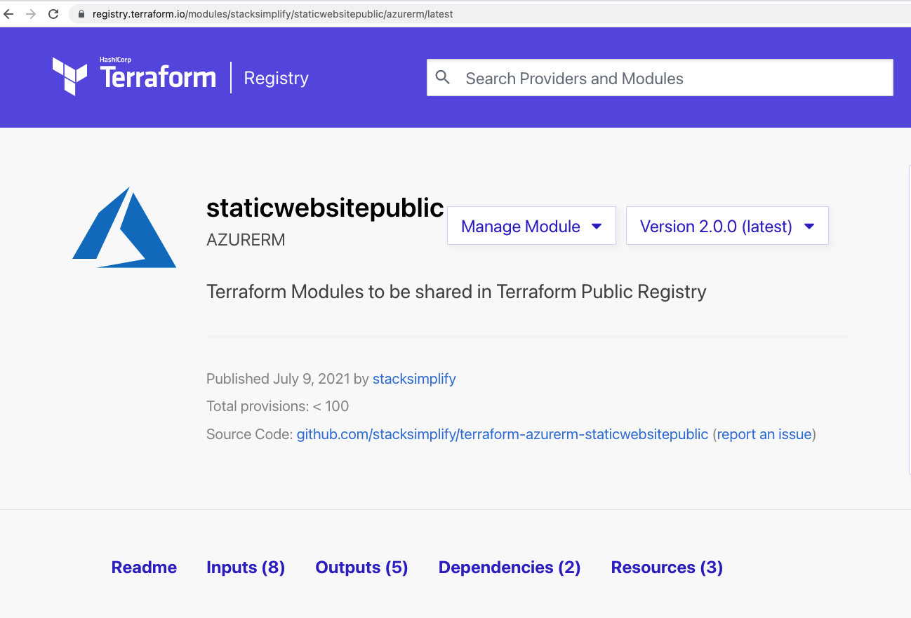
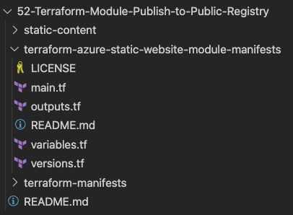
Publish to Public Terraform Registry
Demo 4
Publish to Public Terraform Registry and Access it from Public Registry and Test.

Slide 57
THANK YOU

Slide 58
Terraform
Courses

Slide 59
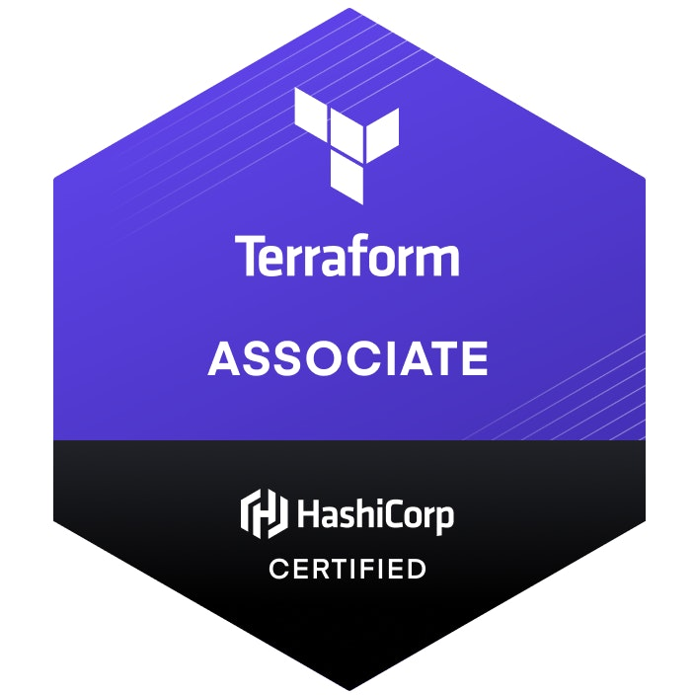
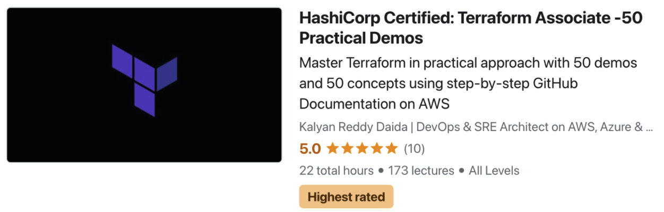
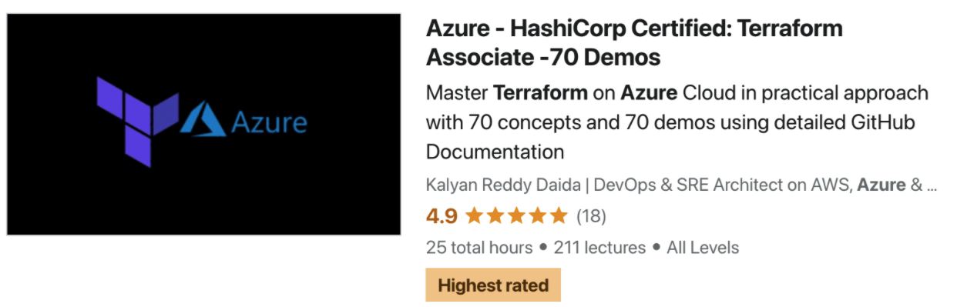
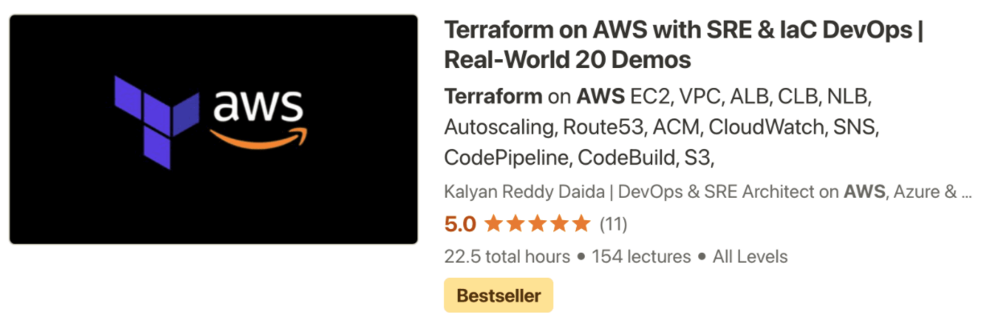
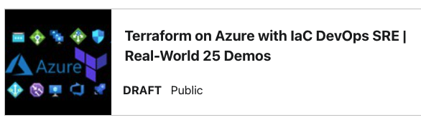
AWS
Azure
Terraform Concepts
Terraform Real-World Implementations on AWS & Azure

Slide 60
Terraform
Fundamentals
Pre-requisite Note

Slide 61
Terraform Fundamentals
We are going to learn Terraform Fundamentals for 3 hours
This section is common for both Azure Terraform Courses
Azure – HashiCorp Certified Terraform Associate 70 Demos
Continue with remaining 60 Demos
Terraform on Azure with IaC DevOps SRE | Real-World 25 Demos
Continue with Real-World 25 Demos

Slide 62
Terraform
Infrastructure as Code
IaC

Slide 63
What is Infrastructure as Code ?

Slide 64

Traditional Way of Managing Infrastructure
Admin-1
Admin-1
Admin-2
Admin-2
Admin-2
Documentation
Dev
QA
Staging
Production
Disaster
Recovery
5 Days
5 Days
5 Days
5 Days
5 Days
Total Time: 25 Days

Slide 65
Traditional Way of Managing Infrastructure
Admin-1
Admin-1
Admin-2
Admin-2
Admin-2
Documentation
(Steps Missing)
Dev
QA
Staging
Production
Disaster
Recovery
No CI
Delays
Issues
Outages
Not-in-Sync
Many Problems at many places in manual process

Slide 66


Traditional Way of Managing Infrastructure
Admin-1
Admin-1
Admin-2
Admin-2
Admin-2
Documentation
Dev
QA
Staging
Production
Disaster
Recovery
Dev
QA
Staging
Production
Disaster
Recovery
Admin-3
Admin-3
Admin-4
Admin-4
Admin-4
Documentation
Infrastructure scalability – Workforce need to be increased to meet the timelines

Slide 67
Traditional Way of Managing Infrastructure
Prod-1
Prod-2
Prod-3
Prod-4
Scale Up
Prod-1
Prod-2
Scale Down
On-Demand Scale-Up and Scale-Down is not an option

Slide 68


Manage using IaC with Terraform
5 Days
Admin-1
Github
DevOps / CI CD for IaC
Check-In TF Code
Triggers
TF Runs
Terraform
Cloud
Scale-Up and Scale-Down On-Demand
Creates Infra
Dev
QA
Staging
Production
Disaster
Recovery
One-Time
Work
Re-Use
Templates
Quick & Fast
Reliable
Tracked for Audit
Total Time: 25 Days reduced to 5 days, Provisioning environments will be in minutes or seconds

Slide 69
Manage using IaC with Terraform
Visibility
IaC serves as a very clear reference of what resources we created, and what their settings are. We don’t have to navigate to the web console to check the parameters.
Stability
If you accidentally change the wrong setting or delete the wrong resource in the web console you can break things. IaC helps solve this, especially when it is combined with version control, such as Git.
Scalability
With IaC we can write it once and then reuse it many times. This means that one well written template can be used as the basis for multiple services, in multiple regions around the world, making it much easier to horizontally scale.
Security
Once again IaC gives you a unified template for how to deploy our architecture. If we create one well secured architecture we can reuse it multiple times, and know that each deployed version is following the same settings.
Audit
Terraform not only creates resources it also maintains the record of what is created in real world cloud environments using its State files.

Slide 70
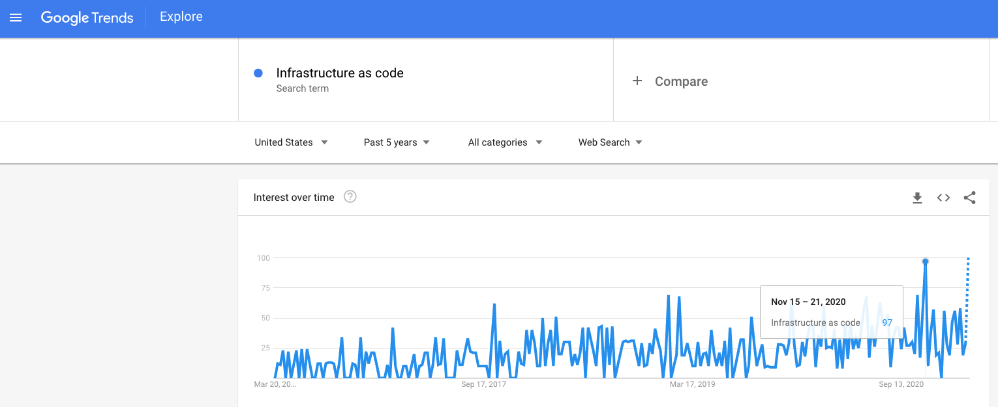
Google Trends – Past 5 Years

Slide 71
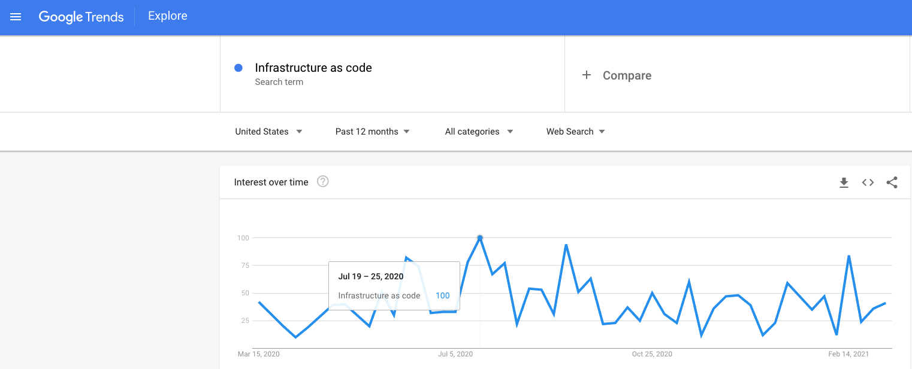
Google Trends – Past 1 Year

Slide 72
Terraform
Installation

Slide 73
Terraform Installation
Terraform CLI
Azure CLI
VS Code Editor
Terraform plugin for VS Code
GIT Client
Mac OS
Windows OS
Linux OS

Slide 74
Terraform
Command Basics

Slide 75
Terraform Workflow
init
validate
plan
apply
destroy
1
2
3
4
5
terraform init
terraform validate
terraform plan
terraform apply
terraform destroy

Slide 76
Terraform Workflow
init
validate
plan
apply
destroy
1
2
3
4
5
Used to Initialize a working directory containing terraform config files
This is the first command that should be run after writing a new Terraform configuration
Downloads Providers
Validates the terraform configurations files in that respective directory to ensure they are syntactically valid and internally consistent.
Creates an execution plan
Terraform performs a refresh and determines what actions are necessary to achieve the desired state specified in configuration files
Used to apply the changes required to reach the desired state of the configuration.
By default, apply scans the current directory for the configuration and applies the changes appropriately.
Used to destroy the Terraform-managed infrastructure
This will ask for confirmation before destroying.

Slide 77
Terraform
Language Basics
Theoretical but Very Important

Slide 78
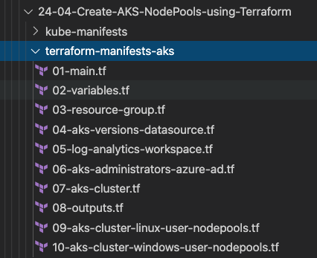
Terraform Language Basics – Files
Terraform Working Directory
Code in the Terraform language is stored in plain text files with the .tf file extension.
There is also a JSON-based variant of the language that is named with the .tf.json file extension.
We can call the files containing terraform code as Terraform Configuration Files or Terraform Manifests
Terraform Configuration Files ending with .tf as extension

Slide 79
Terraform Language Basics – Configuration Syntax
Blocks
Arguments
HCL – HashiCorp Language
Terraform
Identifiers
Comments

Slide 80
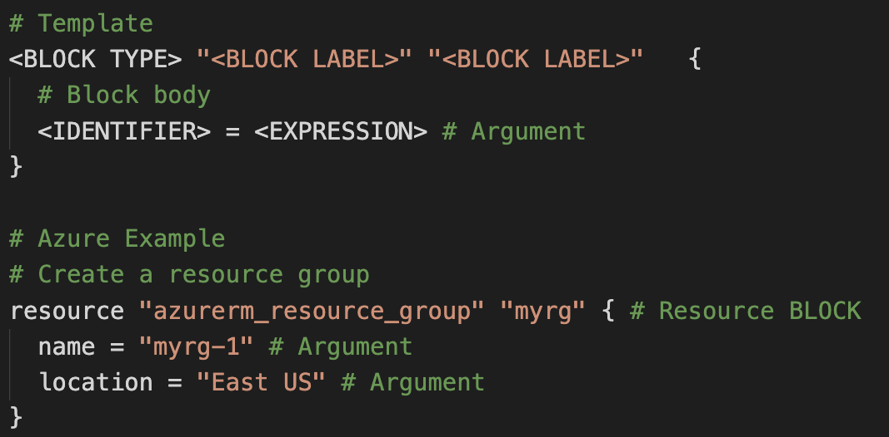
Terraform Language Basics – Configuration Syntax
Block Labels
Block Type
Based on Block Type block labels will be 1 or 2
Example: Resource – 2 labels
Variables – 1 label
Top Level & Block inside Blocks
Top Level Blocks: resource, provider
Arguments
Block Inside Block: provisioners, resource specific blocks like tags

Slide 81
Terraform Language Basics – Configuration Syntax
Argument Name
[or]
Identifier
Argument Value
[or]
Expression

Slide 82
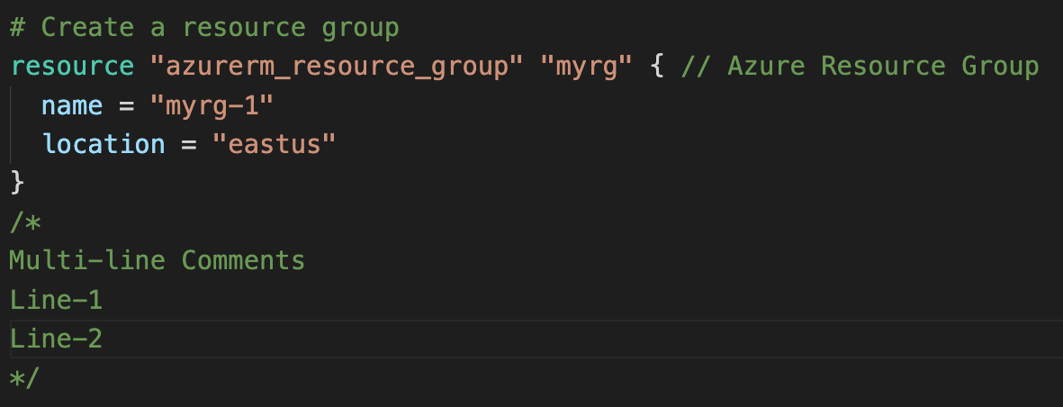
Terraform Language Basics – Configuration Syntax
Single Line Comments with # or //
Multi-line comment

Slide 83
Terraform language uses a limited number of top-level block types, which are blocks that can appear outside of any other block in a TF configuration file.
Terraform
Top-Level
Blocks
Most of Terraform's features are implemented as top-level blocks.
Terraform Block
Input Variables Block
Data Sources Block
Providers Block
Output Values Block
Modules Block
Resources Block
Local Values Block
Fundamental Blocks
Variable Blocks
Calling / Referencing Blocks

Slide 84
Terraform
Fundamental Blocks
Terraform, Provider, Resources

Slide 85
Terraform Basic Blocks
Terraform
Block
Provider
Block
Resource
Block
Special block used to configure some behaviors
HEART of Terraform
Each Resource Block describes one or more Infrastructure Objects
Specifying a required Terraform CLI Version
Terraform relies on providers to interact with Remote Systems
Resource Syntax:
How to declare Resources?
Specifying Provider Requirements & Versions
Declare providers for Terraform to install providers & use them
Resource Behavior: How Terraform handles resource declarations?
Configuring a Terraform Backend (Terraform State)
Provider configurations belong to Root Module
Provisioners: We can configure Resource post-creation actions

Slide 86
Terraform
Block

Slide 87
Terraform Block
This block can be called in 3 ways. All means the same.
Terraform Block
Terraform Settings Block
Terraform Configuration Block
Each terraform block can contain a number of settings related to Terraform's behavior.
Within a terraform block, only constant values can be used; arguments may not refer to named objects such as resources, input variables, etc, and may not use any of the Terraform language built-in functions.

Slide 88
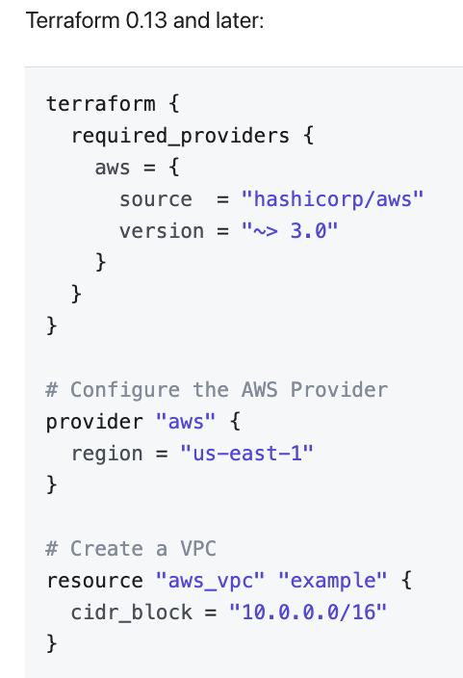
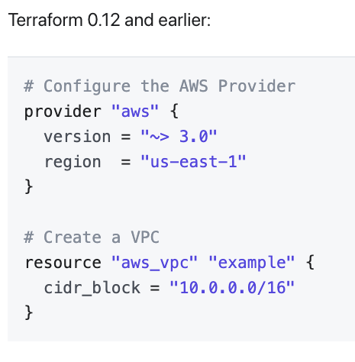
Terraform Block from 0.13 onwards

Slide 89
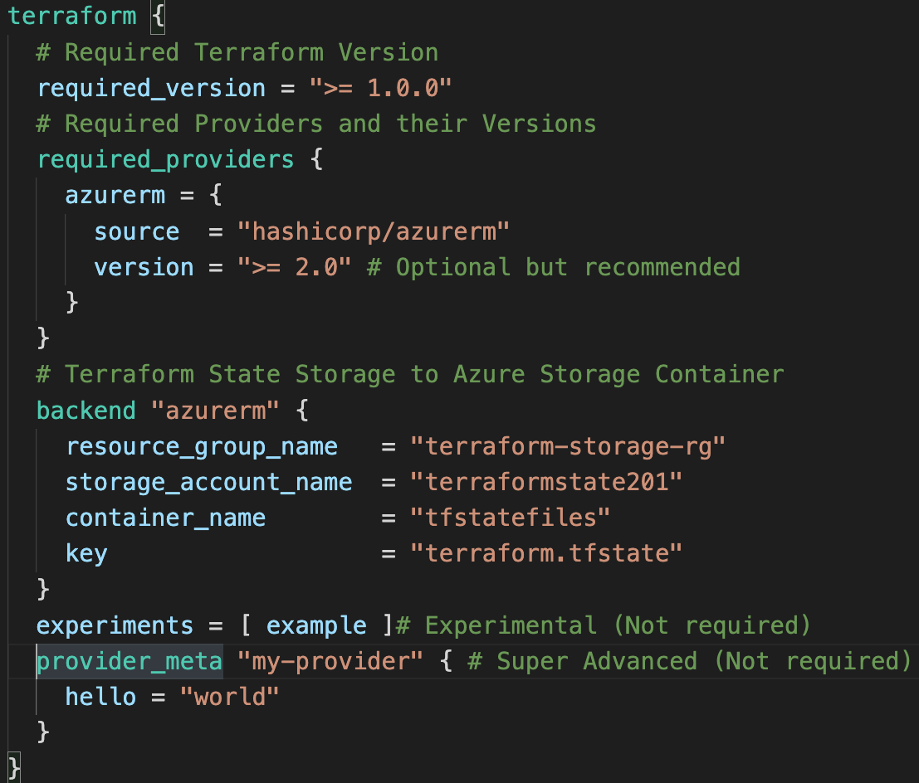
Terraform Block
Required Terraform Version
Provider Requirements
Terraform Block
Terraform Backend
Experimental Language Features
Passing Metadata to
Providers

Slide 90
Terraform
Providers

Slide 91




Terraform Providers
Providers are HEART of Terraform
Every Resource Type (example: Azure Resource Group), is implemented by a Provider
Without Providers Terraform cannot manage any infrastructure.
Terraform Admin
Providers are distributed separately from Terraform and each provider has its own release cycles and Version Numbers
Terraform Registry is publicly available which contains many Terraform Providers for most major Infra Platforms
Local Desktop
1
terraform init
Terraform CLI
Azure Cloud
Download Provider
Terraform Registry
3
terraform plan
4
terraform apply
Azure
APIs
Terraform Azure
Provider
5
terraform destroy
2
terraform validate
Resource Group

Slide 92
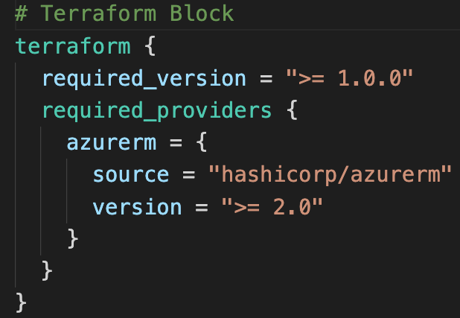
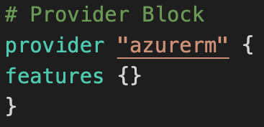
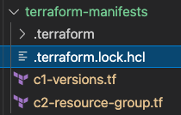
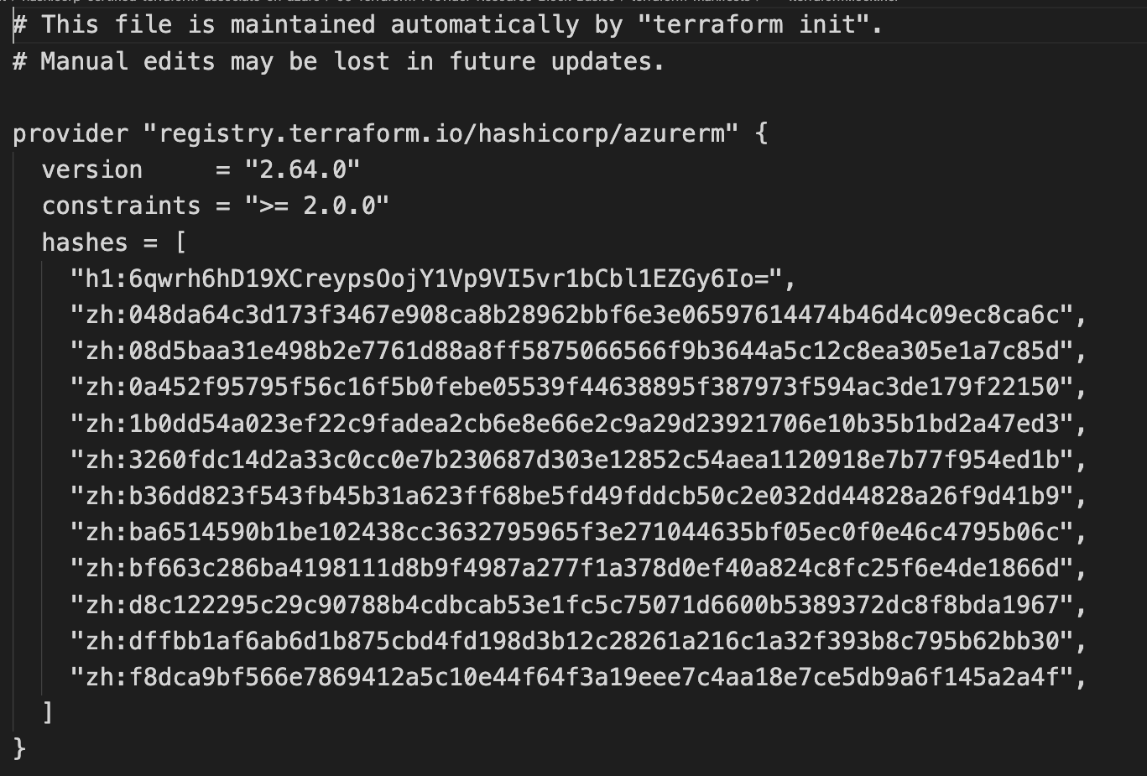
Terraform
Providers
Provider Requirements
Provider Configuration
Dependency Lock File

Slide 93
Dependency Lock File

Slide 94
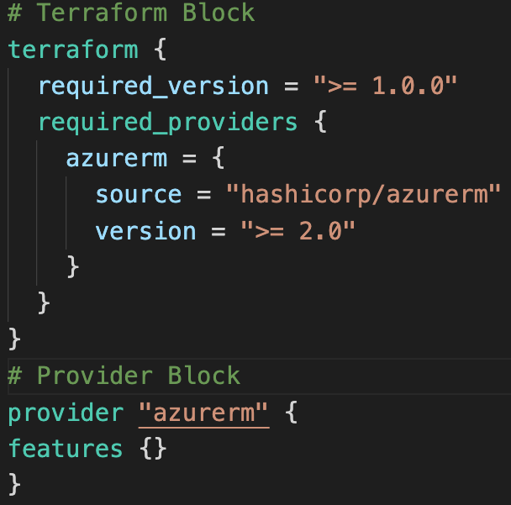
Required Providers
Local Names
Local Names are Module specific and should be unique per-module
Terraform configurations always refer to local name of provider outside required_provider block
Users of a provider can choose any local name for it (myazure, azure1, azure2).
Recommended way of choosing local name is to use preferred local name of that provider (For Azure Provider: hashicorp/azurerm, preferred local name is azurerm)
Source
It is the primary location where we can download the Terraform Provider
Source addresses consist of three parts delimited by slashes (/)
[<HOSTNAME>/]<NAMESPACE>/<TYPE>
registry.terraform.io/hashicorp/azurerm
Registry Name is optional as default is going to be Terraform Public Registry

Slide 95



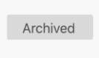
Terraform Registry
Terraform Provider Registry
Providers
registry.terraform.io
Modules
Provider Badges
These are owned and maintained by HashiCorp
Provider Documentation
These are owned and maintained by third-party technology partners. HashiCorp has verified the authenticity of the Provider’s publisher
Community providers are published to the Terraform Registry by individual maintainers, groups of maintainers, or other members of the Terraform community.
Archived Providers are Official or Verified Providers that are no longer maintained by HashiCorp or the community.

Slide 96
Terraform
Multiple Providers

Slide 97
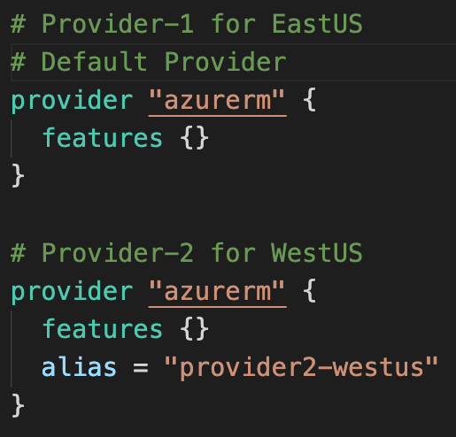
Multiple Providers
We can define multiple configurations for the same provider, and select which one to use on a per-resource or per-module basis.
The primary reason for this is to support multiple regions for a cloud platform

Slide 98
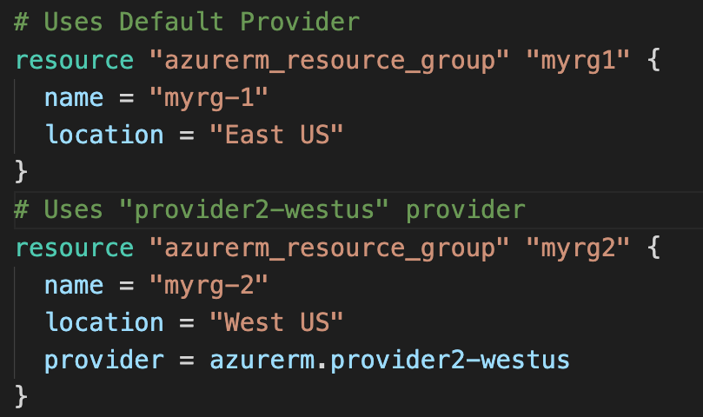
Multiple Providers
We can use the alternate provider in a resource, data or module by referencing it as <PROVIDER NAME>.<ALIAS>

Slide 99
Terraform
Dependency Lock File

Slide 100
Dependency Lock File
New feature added from Terraform v0.14 & later
Terraform
Terraform configuration refers to two different kinds of external dependency that come from outside of its own codebase
Providers
Modules
Version Constraints within the configuration itself determine which versions of dependencies are potentially compatible
Dependency Lock File: After selecting a specific version of each dependency using Version Constraints Terraform remembers the decisions it made in a dependency lock file so that it can (by default) make the same decisions again in future.
Location of Lock File: Current Working Directory
Very Important: Lock File currently tracks only Provider Dependencies. For modules continue to use exact version constraint to ensure that Terraform will always select the same module version.
Checksum Verification: Terraform will also verify that each package it installs matches at least one of the checksums it previously recorded in the lock file, if any, returning an error if none of the checksums match

Slide 101
Dependency Lock File

Slide 102
Importance of Dependency Lock File
If Terraform did not find a lock file, it would download the latest versions of the providers that fulfill the version constraints you defined in the required_providers block inside Terraform Settings Block.
If we have lock file, the lock file causes Terraform to always install the same provider version, ensuring that runs across your team or remote sessions will be consistent.

Slide 103
Terraform
Resources
Introduction

Slide 104
Terraform
Language Basics
Resource
Meta-Argument
count
Terraform
Resource Syntax
Resource
Meta-Argument
depends_on
Terraform
Resources
Terraform
Resource Behavior
Resource
Meta-Argument
for_each
Terraform
State
Resource
Meta-Argument
lifecycle

Slide 105
Terraform
Resource Syntax

Slide 106
Terraform Language Basics – Configuration Syntax
Block Labels
Block Type
Based on Block Type block labels will be 1 or 2
Example: Resource – 2 labels
Variables – 1 label
Top Level & Block inside Blocks
Top Level Blocks: resource, provider
Arguments
Block Inside Block: provisioners, resource specific blocks like tags

Slide 107
Terraform Language Basics – Configuration Syntax
Argument Name
[or]
Identifier
Argument Value
[or]
Expression

Slide 108

Resource Syntax
Resource Type: It determines the kind of infrastructure object it manages and what arguments and other attributes the resource supports.
Resource Local Name: It is used to refer to this resource from elsewhere in the same Terraform module, but has no significance outside that module's scope.
The resource type and name together serve as an identifier for a given resource and so must be unique within a module
Meta-Arguments: Can be used with any resource to change the behavior of resources
Resource Arguments: Will be specific to resource type. Argument Values can make use of Expressions or other Terraform Dynamic Language Features

Slide 109
Terraform
Resource Behavior

Slide 110
Resource Behavior
Create Resource
Create resources that exist in the configuration but are not associated with a real infrastructure object in the state.
Destroy Resource
Destroy resources that exist in the state but no longer exist in the configuration.
Terraform Resource
Update in-place Resources
Update in-place resources whose arguments have changed.
Destroy and re-create
Destroy and re-create resources whose arguments have changed but which cannot be updated in-place due to remote API limitations.
Terraform State

Slide 111
Terraform
State

Slide 112

Terraform State
Terraform must store state about your managed infrastructure and configuration
Terraform
Admin
This state is used by Terraform to map real world resources to your configuration (.tf files), keep track of metadata, and to improve performance for large infrastructures.
Local Desktop
This state is stored by default in a local file named "terraform.tfstate", but it can also be stored remotely, which works better in a team environment.
1
Azure Cloud
terraform init
Terraform CLI
Download Provider
Terraform Registry
Virtual Network
Subnet
Public IP
Terraform Azure
Provider
4
terraform apply
Azure
APIs
5
terraform destroy
Resource Group
Network Interface
2
terraform validate
3
terraform plan
The primary purpose of Terraform state is to store bindings between objects in a remote system and resource instances declared in your configuration.
Terraform State
File
terraform.tfstate
When Terraform creates a remote object in response to a change of configuration, it will record the identity of that remote object against a particular resource instance, and then potentially update or delete that object in response to future configuration changes.

Slide 113
Terraform
State
Desired & Current

Slide 114


Desired & Current Terraform States
Terraform Configuration Files
Real World Resources
terraform.tfstate
Desired State
Current State

Slide 115
Real-World Demo 1
Azure
Virtual Network
Subnets
Network Security Group

Slide 116
Azure Virtual Network – 4 Tier Design
Resource Group
Virtual Network
Web Tier
Subnet
Web
NSG
App Tier
Subnet
App
NSG
DB Tier
Subnet
DB
NSG
Bastion
Host Subnet
Bastion
NSG

Slide 117

Azure Virtual Network Topology

Slide 118
Terraform Concepts & Azure Resources
Terraform Settings Block
Terraform Random Resource
Terraform Provider Block
Terraform for_each Meta-Argument
Terraform Input Variables
Terraform depends_on Meta-Argument
Terraform Local Values Block
Terraform Output Values
azurerm_resource_group
azurerm_network_security_group
azurerm_virtual_network
azurerm_network_security_rule
azurerm_subnet
azurerm_subnet_network_security_group_association

Slide 119

What are we going to Learn ?
Terraform Input Variables
Terraform Local Values
Azure Virtual Network with Subnets and Network Security Groups
Virtual Network 4-Tier
Design
Terraform Output Values
Terraform Meta-Arguments (for_each and depends_on)
Terraform Variable – terraform.tfvars

Slide 120

Time it takes to complete this Demo
Real-World Demo 1

Slide 121
Input variables serve as parameters for a Terraform module, allowing aspects of the module to be customized without altering the module's own source code, and allowing modules to be shared between different configurations.
Input Variables - Basics
1
14 Demos
6
Provide Input Variables using <any-name>.tfvars file with CLI
argument -var-file
Provide Input Variables when prompted during terraform plan or apply
2
7
Provide Input Variables using somefilename.auto.tfvars files
Terraform Input Variables
Override default variable values using CLI argument -var
3
8
Implement complex type constructors like List & Map in Input Variables
Override default variable values using Environment Variables (TF_var_aa)
9
Implement Custom Validation Rules in Variables
4
Provide Input Variables using terraform.tfvars files
5
10
Protect Sensitive Input Variables
13
Input Variables using
Structural Type: Object
11
Input Variables using
Collection Type: set
12
Input Variables using
Structural Type: tuple

Slide 122
Terraform Variables – Output Values
Output values are like the return values of a Terraform module and have several uses
A root module can use outputs to print certain values in the CLI output after running terraform apply.
A child module can use outputs to expose a subset of its resource attributes to a parent module.
1
Terraform Variables
Outputs
2
When using remote state, root module outputs can be accessed by other configurations via a terraform_remote_state data source.
Advanced
3

Slide 123
Output Values – 3 Demos
Demo-1
Demo-2
Demo-3
Basics
Count and Splat Expression
for_each and for loops
Over the process master the for loops in Terraform with Lists and Maps

Slide 124



Terraform Variables – Local Values
A local value assigns a name to an expression, so you can use that name multiple times within a module without repeating it.
Local values are like a function's temporary local variables.
Once a local value is declared, you can reference it in expressions as local.<NAME>.
Local values can be helpful to avoid repeating the same values or expressions multiple times in a configuration
If overused they can also make a configuration hard to read by future maintainers by hiding the actual values used
The ability to easily change the value in a central place is the key advantage of local values.
In short, Use local values only in moderation

Slide 125
Resource Meta-Arguments – depends_on
Use the depends_on meta-argument to handle hidden resource or module dependencies that Terraform can't automatically infer.
The depends_on meta-argument, if present, must be a list of references to other resources or child modules in the same calling module.
Resource
Meta-Argument
depends_on
Explicitly specifying a dependency is only necessary when a resource or module relies on some other resource's behavior but doesn't access any of that resource's data in its arguments.
Arbitrary expressions are not allowed in the depends_on argument value, because its value must be known before Terraform knows resource relationships and thus before it can safely evaluate expressions.
This argument is available in module blocks and in all resource blocks, regardless of resource type.
The depends_on argument should be used only as a last resort. Add comments for future reference about why we added this.

Slide 126

Resource Meta-Arguments – for_each
If a resource or module block includes a for_each argument whose value is a map or a set of strings, Terraform will create one instance for each member of that map or set.
For set of Strings, each.key = each.value
for_each = toset( ["Jack", "James"] )
each.key = Jack
each.key = James
A given resource or module block cannot use both count and for_each
Resource
Meta-Argument
for_each
Each instance has a distinct infrastructure object associated with it, and each is separately created, updated, or destroyed when the configuration is applied.
For Maps, we use each.key & each.value for_each = {
dev = ”myapp1"
} each.key = dev each.value = myapp1
In blocks where for_each is set, an additional each object is available in expressions, so you can modify the configuration of each instance.
each.key — The map key (or set member) corresponding to this instance.
each.value — The map value corresponding to this instance. (If a set was provided, this is the same as each.key.)
for_each with Maps
for_each with Set of Strings
for_each Chaining

Slide 127
Real-World Demo 2
Azure
Virtual Machines
Linux

Slide 128
Azure Linux Virtual Machine
Resource Group
Virtual Network
Web Tier
Subnet
Web
NSG
Web VM-1
Port 80, 22
App Tier
Subnet
App
NSG
User
Web Linux VM
Public IP
NIC
VM
Disk
DB Tier
Subnet
DB
NSG
VM NSG (Optional)
Bastion
Host Subnet
Bastion
NSG

Slide 129


Azure Resources and Topology
azurerm_public_ip
azurerm_network_interface
azurerm_linux_virtual_machine
Azure Disk (automatically
gets created)
azurerm_network_security_group
Terraform file() Function
azurerm_network_security_rule
Terraform filebase64() function
azurerm_network_interface_security_group_association
Terraform base64encode() function

Slide 130

Terraform Configs
VM Custom Data Script to Bootstrap Apache Webserver
SSH Keys to Connect to Linux VM
Azure 4-Tier Virtual Network
Azure Linux VM with Public IP and Network Interface in Web Subnet

Slide 131

Time it takes to complete this Demo
Real-World Demo 2

Slide 132
Real-World Demo 3
Azure
Bastion Host Service
and
Bastion Host Linux VM

Slide 133
Azure Bastion Host Linux VM & Bastion Service
Resource
Group
Virtual Network
Bastion Host
Subnet
Bastion
NSG
SSH Client – Putty / Terminal
Bastion VM-1
Web Tier
Subnet
Web
NSG
Port 22
Bastion Host
Linux VM Public IP
NIC
VM
Disk
Web VM-1
NIC
VM
Disk
Admin
User
App Tier
Subnet
App
NSG
Bastion Service
Subnet
SSL Port 443
DB Tier
Subnet
DB
NSG
Browser
Bastion Service
Public IP
Azure Bastion Service

Slide 134

Azure Bastion Service

Slide 135
Azure Resources
Option-1: Azure Bastion Host Linux VM
azurerm_public_ip
azurerm_network_interface
azurerm_linux_virtual_machine
Option-2: Azure Bastion Service
azurerm_public_ip
Azure Disk (automatically
gets created)
azurerm_subnet
Dedicated Subnet for
Azure Bastion Service
azurerm_network_security_group
Optional
azurerm_network_security_rule
azurerm_bastion_host
azurerm_network_interface_security_group_association

Slide 136

Azure Bastion Options - Topology

Slide 137

Terraform Configs
Azure 4-Tier Virtual Network
Azure Linux VM with Public IP and Network Interface in Web Subnet
Azure Bastion Host Linux VM in Bastion Subnet
Azure Bastion Service in AzureBastionSubnet

Slide 138

Time it takes to complete this Demo
Real-World Demo 3

Slide 139
Terraform Provisioners
Provisioners can be used to model specific actions on the local machine or on a remote machine in order to prepare servers
Passing data into virtual machines and other compute resources
Provisioners are a Last Resort
Running configuration management software (packer, chef, ansible)
First-class Terraform provider functionality may be available
Creation-Time Provisioners
Destroy-Time Provisioners
Failure Behaviour: Continue: Ignore the error and continue with creation or destruction.
Failure Behaviour: Fail: Raise an error and stop applying (the default behavior). If creation provisioner, taint resource

Slide 140
Types of Provisioners
File Provisioner
Provisioner Types
remote-exec Provisioner
local-exec Provisioner
Terraform Null Resource

Slide 141
Terraform New Concepts Introduced
Terraform
Null Resource
Terraform Connection Block
Connect to Azure Bastion Host VM from Terraform CLI Terminal
Terraform File Provisioner
Push terraform-azure.pem to Bastion Host VM
Terraform remote-exec
Provisioner
Provide permissions chmod 400 to terraform-azure.pem after copied to Bastion Host VM

Slide 142

File Provisioner
File Provisioner is used to copy files or directories from the machine executing Terraform to the newly created resource.
The file provisioner supports both ssh and winrm type of connections

Slide 143

remote-exec Provisioner
remote-exec Provisioner
The remote-exec provisioner invokes a script on a remote resource after it is created.
This can be used to run a configuration management tool, bootstrap into a cluster, etc.

Slide 144

Connection Block
Connection Block
Most provisioners require access to the remote resource via SSH or WinRM, and expect a nested connection block with details about how to connect.
Expressions in connection blocks cannot refer to their parent resource by name. Instead, they can use the special self object.

Slide 145
Terraform Null Resource
If you need to run provisioners that aren't directly associated with a specific resource, you can associate them with a null_resource.
Instances of null_resource are treated like normal resources, but they don't do anything.
Same as other resource, you can configure provisioners and connection details on a null_resource.

Slide 146

local-exec Provisioner
local-exec Provisioner
The local-exec provisioner invokes a local executable after a resource is created.
This invokes a process on the machine running Terraform, not on the resource.
Creation Time Provisioner (by default)
Destroy Time Provisioner (when = destroy)

Slide 147
Real-World Demo 4
Azure
Standard
Load Balancer
(using Portal)

Slide 148

Azure Standard Load Balancer
Resource
Group
Virtual Network
Web Tier
Subnet
Web VM-1
Admin
Port 22
SSH Port 1022
NIC
VM
Disk
Web VM-2
Port 22
Inbound NAT Rules
SSH Port 2022
NIC
VM
Disk
Port 80
LB
Public IP
Azure Standard
Load Balancer
Users

Slide 149
Real-World Demo 5
Load Balancer
Virtual Machines
Azure
Standard
Load Balancer

Slide 150
Azure Standard Load Balancer – Internet Facing
Resource
Group
Virtual Network
Bastion Host
Subnet
Bastion
NSG
Port 22
Bastion VM-1
SSH Client – Putty / Terminal
Bastion Host
Linux VM Public IP
NIC
VM
Disk
Port 22
Web Tier
Subnet
Web
NSG
App Tier
Subnet
App
NSG
Web VM-1
Port 80
DB Tier
Subnet
DB
NSG
LB
Public IP
NIC
VM
Disk
Users
Azure Standard
Load Balancer

Slide 151
Azure Resources - Internet Facing
azurerm_public_ip
azurerm_lb
azurerm_lb_backend_address_pool
azurerm_lb_probe
Azure Standard Load Balancer
azurerm_lb_rule
azurerm_network_interface_backend_address_pool_association

Slide 152

Azure Load Balancer - Topology

Slide 153

Azure Load Balancer – Topology

Slide 154


Terraform Configs
Azure Virtual Network with Subnets and Network Security Groups
Azure Virtual Machines + Network Interface + Public IP
Azure Bastion Host Linux VM – Enabled
Azure Bastion Service - Disabled
Azure Standard Load Balancer - Web

Slide 155

Time it takes to complete this Demo
Real-World Demo 5

Slide 156
Real-World Demo 6
Load Balancer
Virtual Machines
Azure
Standard
Load Balancer
Inbound NAT Rules

Slide 157
Azure Standard Load Balancer – Inbound NAT Rules
SSH Client – Putty /
Terminal
Resource
Group
Virtual Network
Bastion Host
Subnet
Bastion
NSG
Port 22
Bastion VM-1
Bastion Host
Linux VM Public IP
NIC
VM
Disk
Admin
Port 22
SSH Port 1022
Web Tier
Subnet
Web
NSG
Inbound NAT Rules
App Tier
Subnet
App
NSG
Port 22
Web VM-1
Port 80
DB Tier
Subnet
DB
NSG
LB
Public IP
NIC
VM
Disk
Users
Azure Standard
Load Balancer

Slide 158
Azure Resources
azurerm_lb
azurerm_public_ip
azurerm_lb_backend_address_pool
azurerm_lb_probe
Azure Standard Load Balancer
azurerm_lb_rule
azurerm_network_interface_backend_address_pool_association
azurerm_lb_nat_rule
azurerm_network_interface_nat_rule_association

Slide 159

Azure Load Balancer – Inbound NAT Rules Topology

Slide 160

Terraform Configs
Azure Virtual Network with Subnets and Network Security Groups
Azure Virtual Machines + Network Interface + Public IP
Azure Bastion Host Linux VM – Enabled
Azure Bastion Service - Disabled
Azure Standard Load Balancer – Web + Inbound NAT Rules

Slide 161

Time it takes to complete this Demo
Real-World Demo 6

Slide 162
Load Balancer
Real-World Demo 7
Virtual Machines
Azure
Multiple VMs
Meta-Argument Count

Slide 163
Resource Meta-Arguments
depends_on
count
Terraform Resources
Meta-Arguments
for_each
provider
Meta-Arguments can be used with any resource type to change the behavior of resources.
lifecycle
Provisioners & Connections

Slide 164


Practical Example with Step-by-Step Documentation on Github
9 Demos for
Meta-Arguments
2 Hour 30 Minutes

Slide 165
Resource Meta-Arguments
depends_on
To handle hidden resource or module dependencies that Terraform can't automatically infer.
count
For creating multiple resource instances according to a count
for_each
To create multiple instances according to a map, or set of strings
provider
For selecting a non-default provider configuration
lifecycle
Standard Resource behavior can be altered using special nested lifecycle block within a resource block body
Provisioners & Connections
For taking extra actions after resource creation (Example: install some app on server or do something on local desktop after resource is created at remote destination)

Slide 166
Azure Standard Load Balancer – Meta-Argument Count
Resource
Group
Virtual Network
Web Tier
Subnet
Web
NSG
Port 22
Web VM-1
Meta-Argument
Count
NIC
VM
Disk
Admin
Port 22
Web VM-2
SSH Port 1022,
SSH Port 2022,
SSH port 3022
NIC
VM
Disk
Inbound NAT Rules
App Tier
Subnet
App
NSG
Port 22
Web VM-3
Port 80
NIC
VM
Disk
DB Tier
Subnet
DB
NSG
Users
LB
Public IP
Azure Standard
Load Balancer

Slide 167


Meta-Argument Count – Input Variable

Slide 168

Meta-Argument Count – Network Interface

Slide 169

Meta-Argument Count – Virtual Machine

Slide 170

Meta-Argument Count – LB Backend Address Pool

Slide 171

Meta-Argument Count – LB NAT Rule

Slide 172

Meta-Argument Count – LB NAT Rule & NIC Association

Slide 173
Terraform Configs
Azure Virtual Network with Subnets and Network Security Groups
Azure Virtual Machines + Network Interface + Public IP
Azure Bastion Host Linux VM – Enabled
Azure Bastion Service - Disabled
Azure Standard Load Balancer – Web + Inbound NAT Rules

Slide 174

Time it takes to complete this Demo
Real-World Demo 7

Slide 175
Load Balancer
Real-World Demo 8
Virtual Machines
Azure
Multiple VMs
Meta-Argument for_each

Slide 176
Azure Standard Load Balancer – Meta-Argument for_each
Resource
Group
Virtual Network
Web Tier
Subnet
Web
NSG
Port 22
Web VM-1
Meta-Argument
for_each
NIC
VM
Disk
Admin
Port 22
Web VM-2
SSH Port 1022,
SSH Port 2022,
SSH port 3022
NIC
VM
Disk
Inbound NAT Rules
App Tier
Subnet
App
NSG
Port 22
Web VM-3
Port 80
NIC
VM
Disk
DB Tier
Subnet
DB
NSG
Users
LB
Public IP
Azure Standard
Load Balancer

Slide 177


Meta-Argument for_each – Input Variable

Slide 178

Meta-Argument for_each – Network Interface

Slide 179

Meta-Argument for_each – Virtual Machine

Slide 180

Meta-Argument for_each – LB Backend Pool

Slide 181

Meta-Argument for_each – Inbound NAT Rules

Slide 182

Terraform – For Loops using Outputs

Slide 183

Terraform – For Loops using Outputs

Slide 184
Terraform Configs
Azure Virtual Network with Subnets and Network Security Groups
Azure Virtual Machines + Network Interface + Public IP
Azure Bastion Host Linux VM – Enabled
Azure Bastion Service - Disabled
Azure Standard Load Balancer – Web + Inbound NAT Rules

Slide 185

Time it takes to complete this Demo
Real-World Demo 8

Slide 186
Real-World Demo 9
Load Balancer
VM
Scale Sets
Azure
Virtual Machine Scale Sets
Manual Scaling
External LB

Slide 187
Azure Standard Load Balancer – VMSS Manual Scaling
Resource
Group
SSH Client – Putty /
Terminal
Virtual Network
Bastion Host
Subnet
Bastion
NSG
Port 22
Bastion VM-1
VMSS
Manual Scaling
Bastion Host
Linux VM Public IP
NIC
VM
Disk
Port 22
Web Tier
Subnet
Web
NSG
App Tier
Subnet
App
NSG
Web VMSS
Port 80
DB Tier
Subnet
DB
NSG
LB
Public IP
Azure Standard
Load Balancer
Web
VMSS NSG
Users

Slide 188

LB Topology

Slide 189

VMSS Manual - Topology

Slide 190


Terraform Dynamic Blocks for VMSS Network Security Group

Slide 191


VMSS Resource – Associate Load Balancer
Not needed when using VMSS

Slide 192


Terraform Configs
Azure Virtual Network with Subnets and Network Security Groups
Azure Virtual Machine Scale Sets with Manual Scaling + Terraform Dynamic Blocks for VMSS NSG
Azure Bastion Host Linux VM – Enabled
Azure Bastion Service - Disabled
Azure Standard Load Balancer – Web + Inbound NAT Rules

Slide 193

Time it takes to complete this Demo
Real-World Demo 9

Slide 194
Load Balancer
Real-World Demo 10
VM
Scale Sets
Azure
Virtual Machine Scale Sets Autoscaling
External LB

Slide 195
Azure Standard Load Balancer + VMSS Auto Scaling
Resource
Group
SSH Client – Putty /
Terminal
Virtual Network
Bastion Host
Subnet
Bastion
NSG
Port 22
Bastion VM-1
VMSS
Autoscaling
Bastion Host
Linux VM Public IP
NIC
VM
Disk
Port 22
Web Tier
Subnet
Web
NSG
App Tier
Subnet
App
NSG
Web VMSS
Port 80
DB Tier
Subnet
DB
NSG
LB
Public IP
Azure Standard
Load Balancer
Web
VMSS NSG
Users

Slide 196
Azure VMSS - Autoscaling
Autoscaling Default Profile
Autoscaling
Recurrence Profile
Autoscaling Fixed Profiles
Mandatory Profile
Recur on those days with start time specified
Executes on that specific day
Defaults to round the clock schedule
Week Day and Weekend profiles
Fixed profile takes priority 1 for execution on that day if exists
Will not execute if Recurrence or Fixed Profile exists
Business Hour and Non-Business Hour profile
P3
P2
P1
Priority Execution Order for Autoscaling Profiles

Slide 197

LB Topology

Slide 198

VMSS Manual - Topology

Slide 199

Autoscaling – Default Profile

Slide 200
Autoscaling Default Profile
Scale Out
Scale In
Default Profile

Slide 201

Autoscaling – What happens to default profile when other profiles present ?

Slide 202
Autoscaling Recurrence Profile Week Days
Recurrence
Week Days

Slide 203
Autoscaling Recurrence Profile Weekends
Recurrence
Weekends

Slide 204
Autoscaling Fixed Profile
Fixed Date
Profile

Slide 205

Autoscaling Run History

Slide 206

Autoscaling Events – Activity Log

Slide 207

Azure Autoscaling Resource – VMSS, App Services

Slide 208

Terraform Configs
Azure Virtual Network with Subnets and Network Security Groups
Azure Virtual Machine Scale Sets with Autoscaling + Terraform Dynamic Blocks for VMSS NSG
Azure Bastion Host Linux VM – Enabled
Azure Bastion Service - Disabled
Azure Standard Load Balancer - Web

Slide 209

Time it takes to complete this Demo
Real-World Demo 10

Slide 210
Real-World Demo 11
Azure
Standard
Load Balancer
External and Internal LB

Slide 211
Azure - External LB + Web VMSS + Internal LB + App VMSS
Internet
Resource
Group
NAT Gateway
Public IP
Virtual Network
NAT Gateway
Web Tier
Subnet
Web
NSG
App Tier
Subnet
App
NSG
Web VMSS
App VMSS
Port 80
Users
LB
Public IP
Azure Standard
Load Balancer
Internal
LB
Web
VMSS NSG
App
VMSS NSG
DB Tier
Subnet
DB
NSG
Storage
Account
Download app1.conf from Storage Container to Web VMSS Apache

Slide 212
Azure - External LB + Web VMSS + Internal LB + App VMSS
Internet
Resource
Group
NAT Gateway
Public IP
SSH Client – Putty /
Terminal
Virtual Network
Bastion Host
Subnet
NAT Gateway
Bastion
NSG
Port 22
Bastion VM-1
Storage
Account
App Tier
Subnet
App
NSG
Bastion Host
Linux VM Public IP
NIC
VM
Disk
Port 22
App VMSS
Port 22
App VMSS NSG
Web Tier
Subnet
Web
NSG
Internal
LB
Web VMSS
Port 80
DB Tier
Subnet
DB
NSG
LB
Public IP
Azure Standard
Load Balancer
Web
VMSS NSG
Users
Download app1.conf from Storage Container to Apache

Slide 213
Azure Resources for Internal LB
azurerm_lb
azurerm_lb_backend_address_pool
azurerm_lb_probe
Azure Standard Load Balancer
azurerm_lb_rule
No Public IP for Internal LB
Internal LB is created in App Subnet
azurerm_network_interface_backend_address_pool_association

Slide 214
Azure Resources
azurerm_public_ip for NAT Gateway
azurerm_nat_gateway
azurerm_nat_gateway_public_ip_association
In addition to App VM and App Load Balancer these Resources are also required
NAT
Gateway
azurerm_subnet_nat_gateway_association
azurerm_storage_account
azurerm_storage_container
Storage
Account
azurerm_storage_blob

Slide 215


Azure Load Balancer – External LB and Internal LB
External LB
Internal LB

Slide 216

Azure Resources - Topology

Slide 217
Terraform Configs
Azure Virtual Network with Subnets and Network Security Groups
Azure Virtual Machine Scale Set with Auto Scaling Profile - Web Tier
Azure Bastion Host Linux VM – Enabled
Azure Bastion Service - Disabled

Slide 218

Terraform Configs
Azure Standard Load Balancer – External Internet facing for Web Tier VMSS Load Balancing
Azure Storage Account – Httpd conf Deployment
Azure NAT Gateway – Outbound communication for App VMSS
Azure Virtual Machine Scale Set with Auto Scaling Profile - App Tier
Azure Standard Load Balancer – Internal for App Tier VMSS Load Balancing

Slide 219

Time it takes to complete this Demo
Real-World Demo 11

Slide 220
Real-World Demo 12
Azure
Load Balancer
VM
Scale Sets
Azure
Private DNS Zones

Slide 221
Azure - Private DNS Zones
Internet
Resource
Group
Private DNS Zone
terraformguru.com
NAT Gateway
Public IP
Virtual Network
applb.terraformguru.com
NAT Gateway
Web Tier
Subnet
Web
NSG
App Tier
Subnet
App
NSG
Web VMSS
App VMSS
Port 80
Users
LB
Public IP
Azure Standard
Load Balancer
Internal
LB
Web
VMSS NSG
App
VMSS NSG
DB Tier
Subnet
DB
NSG
Storage
Account
Download app1.conf from Storage Container to Web VMSS Apache

Slide 222
Azure - Private DNS Zones
Internet
applb.terraformguru.com
Resource
Group
Private DNS Zone
terraformguru.com
NAT Gateway
Public IP
SSH Client – Putty /
Terminal
Virtual Network
Bastion Host
Subnet
NAT Gateway
Bastion
NSG
Port 22
Bastion VM-1
Storage
Account
App Tier
Subnet
App
NSG
Bastion Host
Linux VM Public IP
NIC
VM
Disk
App VMSS
Port 22
Web Tier
Subnet
Web
NSG
Web VMSS
Internal LB
Port 80
DB Tier
Subnet
DB
NSG
Users
LB
Public IP
Azure Standard
Load Balancer
Download app1.conf from Storage Container to Apache

Slide 223
Azure Resources
azurerm_private_dns_zone
azurerm_private_dns_zone_virtual_network_link
Azure
Private DNS
Zone
azurerm_private_dns_a_record for App LB

Slide 224
Terraform Configs
Azure Virtual Network with Subnets and Network Security Groups
Azure Virtual Machine Scale Set with Auto Scaling Profile - Web Tier
Azure Bastion Host Linux VM – Enabled
Azure Bastion Service - Disabled

Slide 225

Terraform Configs
Azure Standard Load Balancer – External (Web Tier Load Balancer)
Azure Storage Account – Deploy httpd conf
Azure NAT Gateway – Outbound communication for App VMSS
Azure Virtual Machine Scale Set with Auto Scaling Profile - App Tier
Azure Standard Load Balancer – Internal (App Tier Load Balancer)
Azure Private DNS Zone for App Tier Load Balancer internal DNS Name in VNET

Slide 226

Time it takes to complete this Demo
Real-World Demo 12

Slide 227
Real-World Demo 13
Azure
Delegate DNS Domain
To
Azure Public DNS Zone

Slide 228
Real-World Demo 14
Azure
Load Balancer
VM
Scale Sets
Azure
Public DNS Zones

Slide 229
Azure - Public DNS Zones
Internet
Resource
Group
Private DNS Zone
terraformguru.com
NAT Gateway
Public IP
Resource
Group
Virtual Network
DNS Records
kubeoncloud.com
www.kubeoncloud.com
app1.kubeoncloud.com
NAT Gateway
applb.terraformguru.com
Public DNS Zone
kubeoncloud.com
Web Tier
Subnet
Web
NSG
App Tier
Subnet
App
NSG
Web VMSS
App VMSS
Port 80
Users
LB
Public IP
Azure Standard
Load Balancer
Internal
LB
http://kubeoncloud.com
http://www.kubeoncloud.com
http://app1.kubeoncloud.com
Web
VMSS NSG
App
VMSS NSG
DB Tier
Subnet
DB
NSG
Storage
Account
Download app1.conf from Storage Container to Web VMSS Apache

Slide 230
Azure - Public DNS Zone
Internet
Resource
Group
Private DNS Zone
NAT Gateway
Public IP
SSH Client – Putty /
Terminal
Virtual Network
Bastion Host
Subnet
NAT Gateway
Bastion
NSG
Port 22
Bastion VM-1
Storage
Account
App Tier
Subnet
App
NSG
Bastion Host
Linux VM Public IP
NIC
VM
Disk
App VMSS
Port 22
Resource
Group
App VMSS NSG
Web Tier
Subnet
Web
NSG
Internal
LB
Web VMSS
Public DNS Zone
DB Tier
Subnet
DB
NSG
app1.kubeoncloud.com
LB
Public IP
Azure Standard
Load Balancer
Web
VMSS NSG
Users
Download app1.conf from Storage Container to Apache

Slide 231
Azure Resources
Datasource: azurerm_dns_zone
azurerm_dns_a_record – Root Record: kubeoncloud.com
azurerm_dns_a_record – www Record: www.kubeoncloud.com
Azure
Public DNS
Zone
azurerm_dns_a_record – app1 Record: app1.kubeoncloud.com

Slide 232
Terraform Configs
Azure Virtual Network with Subnets and Network Security Groups
Azure Virtual Machine Scale Set with Auto Scaling Profile - Web Tier
Azure Bastion Host Linux VM – Enabled
Azure Bastion Service - Disabled

Slide 233
Terraform Configs
Azure Standard Load Balancer – External (Web Tier Load Balancer)
Azure Storage Account – Deploy httpd conf
Azure NAT Gateway – Outbound communication for App VMSS
Azure Virtual Machine Scale Set with Auto Scaling Profile - App Tier
Azure Standard Load Balancer – Internal (App Tier Load Balancer)
Azure Private DNS Zone for App Tier Load Balancer internal DNS Name in VNET
Azure Public DNS Zone – Access Applications via Internet using Registered Domain

Slide 234

Time it takes to complete this Demo
Real-World Demo 14

Slide 235
Real-World Demo 15
Azure
Load Balancer
Terraform
Backend
Remote State Storage
with
Azure Storage Account
VM
Scale Sets

Slide 236
What is Terraform Backend ?
Backends are responsible for storing state and providing an API for state locking.
Terraform State Storage
Terraform State Locking
Azure Storage Account

Slide 237





Local State File
Remote State File
Admin1
Admin2
Admin3
Multiple Team members
cannot update the infrastructure as they don’t have access to State File
Using Terraform Backend concept we can use Azure SA as the shared storage for State Files
Admin1
Admin2
Admin3
Admin1
Desktop
Admin2
Desktop
Admin3
Desktop
This means we need store the state file in a shared location.
If two team members are running Terraform at the same time, you may run into race conditions as multiple Terraform processes make concurrent updates to the state files, leading to conflicts, data loss, and state file corruption.
Admin1
Desktop
Azure
Storage Account
terraform.tfstate
terraform.tfstate
Azure VM
Instance
Azure VM
Instance
Azure Cloud
State Locking
Azure Cloud

Slide 238
Terraform Remote State File with State Locking
Admin1
Admin2
Admin3
Not all backends support State Locking. Azure Storage Account supports State Locking
State locking happens automatically on all operations that could write state.
Admin1
Desktop
Admin2
Desktop
Admin3
Desktop
If state locking fails, Terraform will not continue.
You can disable state locking for most commands with the -lock flag but it is not recommended.
Azure Storage Account
terraform.tfstate
If acquiring the lock is taking longer than expected, Terraform will output a status message.
If Terraform doesn't output a message, state locking is still occurring if your backend supports it.
Azure VM
Instance
Terraform has a force-unlock command to manually unlock the state if unlocking failed.
Azure Cloud

Slide 239

Terraform Remote State File with State Locking
Terraform Remote State Storage

Slide 240


Terraform Configs - Project 1
Terraform Remote Backends – Azure Storage Account
Azure Virtual Network with Subnets and Network Security Groups
Azure Virtual Machine Scale Set with Auto Scaling Profile
Azure Bastion Host Linux VM – Disabled
Azure Bastion Service - Disabled
Azure Standard Load Balancer

Slide 241

Time it takes to complete this Demo
Real-World Demo 15

Slide 242
Terraform
Backends

Slide 243
Terraform Backends
Each Terraform configuration can specify a backend, which defines where and how operations are performed, where state snapshots are stored, etc.
Where Backends are Used
Backend configuration is only used by Terraform CLI.
Terraform Cloud and Terraform Enterprise always use their own state storage when performing Terraform runs, so they ignore any backend block in the configuration.
For Terraform Cloud users also it is always recommended to use backend block in Terraform configuration for commands like terraform taint which can be executed only using Terraform CLI

Slide 244
Terraform Backends
What Backends Do
There are two things backends will be used for
Where state is stored
Where operations are performed.
Store State
State Locking
Operations
Terraform uses persistent state data to keep track of the resources it manages.
State Locking is to prevent conflicts and inconsistencies when the operations are being performed
"Operations" refers to performing API requests against infrastructure services in order to create, read, update, or destroy resources.
Everyone working with a given collection of infrastructure resources must be able to access the same state data (shared state storage).
Not every terraform subcommand performs API operations; many of them only operate on state data.
What are Operations ?
terraform apply
terraform destroy
Only two backends actually perform operations: local and remote.
The remote backend can perform API operations remotely, using Terraform Cloud or Terraform Enterprise.

Slide 245
Terraform Backends
Backend Types
Enhanced Backends
Standard Backends
Enhanced backends can both store state and perform operations. There are only two enhanced backends: local and remote
Standard backends only store state, and rely on the local backend for performing operations.
Example for Remote Backend Performing Operations : Terraform Cloud, Terraform Enterprise
Example: AWS S3, Azure RM, Consul, etcd, gcs http and many more

Slide 246
Real-World Demo 16
Azure
Load Balancer
Azure
Traffic Manager
VM
Scale Sets
Azure
Traffic Manager
Terraform
Remote State Datasource

Slide 247
Terraform Remote State Datasource
Project-1: eastus2
Azure VNET + LB + VMSS
Project-3: eastus2
project-1-terraform.tfstate
Azure Traffic Manager
terraform_remote_state data source
Project-2: westus2
project-3-terraform.tfstate
Azure VNET + LB + VMSS
The terraform_remote_state data source retrieves the root module output values from some other Terraform configuration, using the latest state snapshot from the remote backend.
project-2-terraform.tfstate

Slide 248
Azure – Traffic Manager
Resource
Group
Virtual Network
Region: eastus2
Web Tier
Subnet
Web
NSG
Web VMSS
Web
VMSS NSG
LB
Public IP
Azure Standard
Load Balancer
Resource Group
mytfdemo-wquift.trafficmanager.net
Resource
Group
Virtual Network
Users
Azure Traffic Manager
Region: westus2
Web Tier
Subnet
Web
NSG
Region: eastus2
Web VMSS
Web
VMSS NSG
LB
Public IP
Azure Standard
Load Balancer

Slide 249

Traffic Manager Endpoints

Slide 250



Terraform Backend – Three Projects
Project-1 Terraform State File
Project-2 Terraform State File
Project-3 Terraform State File

Slide 251
Terraform Configs - Project 1 and 2
Project-1 Region: eastus2
Project-2 Region: westus2
Azure Virtual Network with Subnets and Network Security Groups
Azure Virtual Machine Scale Set with Auto Scaling Profile
Azure Bastion Host Linux VM – Disabled
Azure Bastion Service - Disabled
Azure Standard Load Balancer

Slide 252

Terraform Configs – Project 3
Terraform Remote State Datasource to access Project-1 and Project-2 Public IP SLB
Traffic Manager Project Generic Resources (RG, locals, Input Variables, Random Resources)
Azure Traffic Manager Resource

Slide 253

Terraform Remote State Data source

Slide 254

Time it takes to complete this Demo
Real-World Demo 16

Slide 255
Real-World Demo 17 & 18
Application
Gateway
VM
Scale Sets
Azure
Application Gateway
using
Azure Portal & Terraform

Slide 256

Azure Application Gateway

Slide 257
Azure Application Gateway Components

Slide 258
Azure Application Gateway – using Azure Portal
Create Azure Application Gateway manually
Resource
Group
AG – Backend Pools
Virtual Network
AG – Frontend IP Configs
App Tier
Subnet
App
NSG
AG – Listeners
Create AG using Azure Portal
DB Tier
Subnet
DB
NSG
AG – HTTP Settings
AG – Rules
AG – Health Probes
AG
NSG
Web Tier
Subnet
Web
NSG
AG Subnet
Port 80
Web VMSS
Azure Application
Gateway LB
LB Public IP
Users

Slide 259
Azure Application Gateway – using Terraform
Create Azure Application Gateway using Terraform
Resource
Group
AG – Backend Pools
Virtual Network
AG – Frontend IP Configs
App Tier
Subnet
App
NSG
AG – Listeners
DB Tier
Subnet
DB
NSG
AG – HTTP Settings
AG – Rules
AG – Health Probes
AG
NSG
Web Tier
Subnet
Web
NSG
AG Subnet
Port 80
Web VMSS
Azure Application
Gateway LB
LB Public IP
Users

Slide 260
Azure Application Gateway
Resource
Group
SSH Client – Putty /
Terminal
Virtual Network
Bastion Host
Subnet
Bastion
NSG
App Tier
Subnet
App
NSG
Port 22
Bastion VM-1
DB Tier
Subnet
DB
NSG
Bastion Host
Linux VM Public IP
NIC
VM
Disk
Port 22
AG
NSG
Web Tier
Subnet
Web
NSG
AG Subnet
Port 80
Web VMSS
Azure Application
Gateway LB
Users
LB Public IP

Slide 261

Azure Application Gateway - Topology

Slide 262

Azure Application Gateway + VMSS - Topology

Slide 263

Terraform Configs
Azure Virtual Network with Subnets and Network Security Groups
Azure Virtual Machine Scalesets with Autoscaling enabled

Slide 264

Terraform Configs
Azure Bastion Linux VM – Disabled
Azure Bastion Service - Disabled
Azure Application Gateway

Slide 265

Time it takes to complete this Demo
Real-World Demo 17 & 18

Slide 266
Real-World Demo 19
Application
Gateway
VM
Scale Sets
Azure
Application Gateway
Context Path Routing

Slide 267
Azure Application Gateway – Context Path based Routing
Resource
Group
Virtual Network
Web Tier
Subnet
Web
NSG
App1 VMSS
http://ag-public-ip/app1/
+
http://ag-public-ip/app2/
AG
NSG
http://ag-public-ip/
AG Subnet
/app1/*
/app2/*
Azure Application
Gateway LB
Users
LB Public IP
/*
App2 VMSS
+
External Site
stacksimplify.com

Slide 268
Azure Application Gateway Components

Slide 269

Azure Application Gateway Context Path Routing

Slide 270

Azure Application Gateway Context Path Routing

Slide 271
Path Based Routing
Root Context
External Redirect
Context Path based Routing

Slide 272

Path based Routing Rule

Slide 273

Path based Routing Rule

Slide 274

Default Root Context - Redirection

Slide 275


Terraform Configs
Azure Virtual Network with Subnets and Network Security Groups
Azure Virtual Machine Scalesets with Autoscaling enabled
Azure Bastion Linux VM – Disabled
Azure Bastion Service - Disabled

Slide 276

Terraform Configs
Azure Application Gateway

Slide 277

Time it takes to complete this Demo
Real-World Demo 19

Slide 278
Real-World Demo 20
Application
Gateway
VM
Scale Sets
Azure
Application Gateway
Multisite Hosting

Slide 279
Azure Application Gateway – Multisite Hosting
Resource
Group
Virtual Network
Web Tier
Subnet
Web
NSG
App1 VMSS
http://app1.terraformguru.com/index.html
http://app1.terraformguru.com/app1/index.html
+
AG Subnet
app1.terraformguru.com
Azure Application
Gateway LB
app2.terraformguru.com
Users
LB Public IP
AG
NSG
App2 VMSS
http://app2.terraformguru.com/index.html
http://app2.terraformguru.com/app2/index.html
+

Slide 280
Azure Application Gateway Components

Slide 281

Azure Application Gateway Multisite Hosting

Slide 282

Azure Application Gateway - Listeners

Slide 283


Azure Application Gateway Listeners

Slide 284

Azure Application Gateway - Listeners

Slide 285


Azure Application Gateway - Routing Rules

Slide 286


Azure Application Gateway - Routing Rules

Slide 287

Azure Application Gateway - Routing Rules

Slide 288

Azure Application Gateway – Health Probes

Slide 289

VMSS Topology App1 and App2

Slide 290
Terraform Configs
Azure Virtual Network with Subnets and Network Security Groups
Azure Virtual Machine Scalesets with Autoscaling enabled
Azure Bastion Linux VM – Disabled
Azure Bastion Service - Disabled

Slide 291
Terraform Configs
Azure Application Gateway

Slide 292

Time it takes to complete this Demo
Real-World Demo 20

Slide 293
Real-World Demo 21
Application
Gateway
VM
Scale Sets
Azure
Application Gateway
Self Signed SSL
Http to Https Redirect
Error Pages 502 and 403

Slide 294
Azure Application Gateway – SSL Self-signed
Resource
Group
Virtual Network
Web Tier
Subnet
Web
NSG
App1 VMSS
+
AG Subnet
Azure Application
Gateway LB
http://terraformguru.com
https://terraformguru.com
HTTP
To
HTTPs
Redirect
SSL
Certs
AG
Error
Pages
Azure
Storage
Account
Users
LB Public IP
AG
NSG
502.html
403.html

Slide 295
Azure Application Gateway Components

Slide 296

Azure Application Gateway – SSL

Slide 297

VMSS Topology

Slide 298

HTTPS Listener Error Pages

Slide 299


HTTP to HTTPS Redirect Routing Rule

Slide 300


Terraform Configs
SSL Self-Signed Certificates
Azure Virtual Network with Subnets and Network Security Groups
Azure Virtual Machine Scalesets with Autoscaling enabled
Azure Bastion Linux VM – Disabled
Azure Bastion Service - Disabled

Slide 301

Terraform Configs
Azure Application Gateway
Azure Storage Account for AG Error Pages

Slide 302

Time it takes to complete this Demo
Real-World Demo 21

Slide 303
Real-World Demo 22
Azure Key Vault
Application
Gateway
VM
Scale Sets
Azure
Application Gateway
Self Signed SSL
Azure Key Vault
User Managed
Identity

Slide 304
Azure Application Gateway – SSL from Key Vault
Resource
Group
Virtual Network
Web Tier
Subnet
Web
NSG
AG Subnet
Azure Application
Gateway LB
http://terraformguru.com
https://terraformguru.com
App1 VMSS
+
HTTP
To
HTTPs
Redirect
SSL
Certs
AG
Error
Pages
Users
LB Public IP
Azure
Storage
Account
AG
NSG
Access SSL Certificate from Key Vault
502.html
403.html
Azure Key Vault
User Assigned
Managed Identity

Slide 305

What is User-assigned Managed Identity?

Slide 306

Azure Application Gateway HTTPS Listener SSL Certificate associated from Azure Key Vault

Slide 307

Azure Key Vault – SSL Certificate Import

Slide 308
Terraform Configs
SSL Self-Signed Certificates
Azure Virtual Network with Subnets and Network Security Groups
Azure Virtual Machine Scalesets with Autoscaling enabled
Azure Bastion Linux VM – Disabled
Azure Bastion Service - Disabled

Slide 309

Terraform Configs
Azure Application Gateway + User Managed Identity
Azure Storage Account for AG Error Pages
Azure Key Vault for SSL Certs

Slide 310

Time it takes to complete this Demo
Real-World Demo 22

Slide 311

Github
Azure
DevOps
Azure
Pipelines
Real-World Demo 23
Starter
Pipelines
Azure
IaC DevOps
Continuous Integration & Delivery Pipelines
Azure Build & Release Pipelines

Slide 312
Azure Pipelines – Key Concepts
Pipeline
Stages
Steps
Trigger
Stage-1: Build
Agent
Step-1: script: List Command: ls -R $(System.DefaultWorkingDirectory)
Job
Stage-2: AA
Step-2: Task-2: Copy Files to Build Artifact Directory
Github
Agent
Stage-3: BB
Job
Step-3: script: List Command: ls -R $(Build.ArtifactStagingDirectory)
Stage-4: CC
Job
Step-4: Task-3: Publish Artifacts to Azure Pipelines
Developer

Slide 313
Azure DevOps – Build Pipeline
Continuous Integration Pipeline
Task-1
Copy files (terraform-manifests folder) from System default working Directory to Build Artifact Directory
Task-2
Publish Build Artifacts to Azure Pipelines, so that we can use them in Release Pipelines

Slide 314
Developer
Github
Azure DevOps – Release Pipelines
1
2
Azure Cloud
Azure DevOps
Release Pipelines
QA
Azure Pipelines
5
Stage-1: Publish Artifacts to Release Pipelines
3
Dev
Staging
9
Prod
Storage Account
for State Files
7
4
6
10
8
Resource Group
Resource Group
Resource Group
Resource Group
Virtual Network
Virtual Network
Virtual Network
Virtual Network
Web Subnet
Web Subnet
Web Subnet
Web Subnet
Dev VM
Web
NSG
QA VM
Web
NSG
Stage VM
Web
NSG
Prod VM
Web
NSG
Public IP
Public IP
Public IP
Public IP

Slide 315
Azure IaC DevOps – Release Pipeline

Slide 316
Azure IaC DevOps Release Pipelines

Slide 317
Azure IaC DevOps Releases

Slide 318
Azure IaC DevOps Releases

Slide 319
Azure IaC DevOps Environment TF State Files

Slide 320




Virtual Network Subnets - 4 Environments
Dev
QA
Prod
Stage

Slide 321



4 Environments - Resources
Resource Groups
Public IP
Virtual Machines

Slide 322

Terraform Configs
Azure Virtual Network with Subnets and Network Security Group Resources
Azure Web Linux VM with Public IP and Network Interface Resources
Environment specific tfvar files terraform apply –auto-approve –var-file=dev.tfvars terraform apply –auto-approve –var-file=qa.tfvars

Slide 323
Time it takes to complete this Demo
Real-World Demo 23

Slide 324
Github
Azure
DevOps
Azure
Pipelines
Starter
Pipelines
Real-World Demo 23
Azure
IaC DevOps
Continuous Integration Pipelines
Build Pipelines

Slide 325
Azure Pipelines – Key Concepts
Pipeline
Stages
Steps
Trigger
Stage-1: Build
Agent
Step-1: script: List Command: ls -R $(System.DefaultWorkingDirectory)
Job
Stage-2: AA
Step-2: Task-2: Copy Files to Build Artifact Directory
Github
Agent
Stage-3: BB
Job
Step-3: script: List Command: ls -R $(Build.ArtifactStagingDirectory)
Stage-4: CC
Job
Step-4: Task-3: Publish Artifacts to Azure Pipelines
Developer

Slide 326

Azure Pipelines – Key Concepts
Stages
Stage-1
Jobs
Job-1
Steps
Step-1: Script
Step-2: Task
Job-2
Steps
Step-1: Task
Step-2: Task
Stage-2
Jobs
Job-1
Steps
Step-1: Script
Step-2: Script
Job-2
Steps
Step-1: Task
Step-2: Task

Slide 327
Azure DevOps – Build Pipeline
Continuous Integration Pipeline
Task-1
Copy files (terraform-manifests folder) from System default working Directory to Build Artifact Directory
Task-2
Publish Build Artifacts to Azure Pipelines, so that we can use them in Release Pipelines

Slide 328

Azure IaC DevOps – CI/Build Pipeline

Slide 329

Azure IaC DevOps – CI/Build Pipeline

Slide 330

Azure IaC DevOps – CI/Build Pipeline

Slide 331
Azure DevOps Parallelism Request
Agent: 1800 Minutes Free

Slide 332

Azure DevOps Parallelism Request
Usually, it takes 2 to 3 business days for approval.
It got approved for me in 24 hours.

Slide 333
Github
Azure
DevOps
Azure
Pipelines
Azure
Release
Pipelines
Starter
Pipelines
Real-World Demo 23
Azure
IaC DevOps
Continuous Delivery Pipelines
Release Pipelines

Slide 334

Azure DevOps – Release Pipelines
To achieve Continuous Delivery we use Release Pipelines

Slide 335

Azure DevOps – Release Pipelines

Slide 336
Developer
Github
Azure DevOps – Release Pipelines
1
2
Azure Cloud
Azure DevOps
Release Pipelines
QA
Azure Pipelines
5
Stage-1: Publish Artifacts to Release Pipelines
3
Dev
Staging
9
Prod
Storage Account
for State Files
7
4
6
10
8
Resource Group
Resource Group
Resource Group
Resource Group
Virtual Network
Virtual Network
Virtual Network
Virtual Network
Web Subnet
Web Subnet
Web Subnet
Web Subnet
Dev VM
Web
NSG
QA VM
Web
NSG
Stage VM
Web
NSG
Prod VM
Web
NSG
Public IP
Public IP
Public IP
Public IP

Slide 337
Azure IaC DevOps – Release Pipeline

Slide 338
Azure IaC DevOps Release Pipelines

Slide 339
Azure IaC DevOps Releases

Slide 340
Azure IaC DevOps Environment TF State Files

Slide 341
Virtual Network Subnets - 4 Environments
Dev
QA
Prod
Stage

Slide 342
4 Environments - Resources
Resource Groups
Public IP
Virtual Machines

Slide 343
Real-World Demo 24
MySQL Server
Application
Gateway
VM
Scale Sets
Azure
MySQL Single Server

Slide 344

Azure MySQL Deployment Options
Terraform Resource not available as on today

Slide 345
Azure MySQL Single Server
Azure Cloud
Resource
Group
Virtual Network
Web Tier
Subnet
App1 VMSS
+
VNET Service Endpoint
Web
NSG
MySQL Virtual Network Rule
AG Subnet
Azure Application
Gateway LB
http://terraformguru.com
https://terraformguru.com
HTTP
To
HTTPs
Redirect
SSL
Certs
AG
Error
Pages
Azure
Storage
Account
Azure MySQL Single Server
LB Public IP
Users
AG
NSG
502.html
403.html

Slide 346

Azure MySQL Single Server with Virtual Network Rules

Slide 347
Azure Resources
Terraform Concepts
Azure MySQL Single Server
Input Variables – name.auto.tfvars
azurerm_mysql_server
Input Variables – -var-file=secrets.tfvars
azurerm_mysql_database
Input Variables Sensitive Flag = True
azurerm_mysql_firewall_rule
azurerm_mysql_virtual_network_rule

Slide 348
User Management Web Application
Spring Boot User Management
Web Application
(Java)
MySQL DB
UMS Web App with Create User, List User, Login and Logout Features
UMS Web App DB information can be passed via Environment Variables (DB Name, Port User, Pass)
UMS Web App Listens on Port 8080
New users created will be stored in MySQL DB
UMS Web App needs MySQL DB to store its users. If connection to DB fails, it cannot start
We can login with new users created to UMS Web App

Slide 349

User Management Web Application Custom Data

Slide 350
UMS – Login Screen

Slide 351
UMS – Landing Page Post Login

Slide 352
UMS – List Users Screen

Slide 353

UMS Create Users Screen

Slide 354

UMS List Users after Create User

Slide 355

UMS Login with newly Created User

Slide 356
Terraform Configs
SSL Self-Signed Certificates
Azure Virtual Network with Subnets and Network Security Groups
Azure Virtual Machine Scalesets with Autoscaling enabled
Azure Bastion Linux VM – Enabled
Azure Bastion Service - Disabled

Slide 357

Terraform Configs
Azure Application Gateway + Storage Account for AG Error Pages
Azure MySQL Single Server
Terraform Input Variables mysqldb.auto.tfvars
Terraform Input Variables
secrets.tfvars

Slide 358

Time it takes to complete this Demo
Real-World Demo 24

Slide 359
Terraform
Modules

Slide 360
Terraform Modules
Modules are containers for multiple resources that are used together. A module consists of a collection of .tf files kept together in a directory.
Modules are the main way to package and reuse resource configurations with Terraform.
A module that has been called by another module is often referred to as a child module.
Every Terraform configuration has at least one module, known as its root module, which consists of the resources defined in the .tf files in the main working directory
Child modules can be called multiple times within the same configuration, and multiple configurations can use the same child module.
A Terraform module (usually the root module of a configuration) can call other modules to include their resources into the configuration.
In addition to modules from the local filesystem, Terraform can load modules from a public or private registry.
This makes it possible to publish modules for others to use, and to use modules that others have published.

Slide 361

Terraform Registry – Use Publicly Available Modules
The Terraform Registry hosts a broad collection of publicly available Terraform modules for configuring many kinds of common infrastructure.
Demo 1
These modules are free to use, and Terraform can download them automatically if you specify the appropriate source and version in a module call block.

Slide 362


Build manually and then automate using Terraform
1. Build a Static Website using Azure manually using Azure Portal.
2. Automate it using Terraform Resources
Demo 2

Slide 363


Build a Local Terraform Module
Demo 3
Build a Local Terraform Module and call it from Root Module and Test

Slide 364
Publish to Public Terraform Registry
Demo 4
Publish to Public Terraform Registry and Access it from Public Registry and Test.

Slide 365


Use various Module Sources
Demo 5
In addition to Terraform Public and Private Registry use various module sources.

Slide 366


Private Module Registry in Terraform Cloud & Enterprise
Members of your organization might produce modules specifically crafted for your own infrastructure needs.
Terraform Cloud and Terraform Enterprise both include a private module registry for sharing modules internally within your organization.
Demo 6

Slide 367


Practical Examples & Step-by-Step Documentation on Github
2 Hour 10 Minutes

Slide 368
ALL LIVE SLIDES ARE BEFORE THIS SLIDE

